Slide 1
Plants are Friends!
Melissa Wilmarth
Nashville Software School
DDA13 Aug 2024
Notes:
Thank you for attending my capstone presentation on houseplants. Why houseplants?

Slide 2
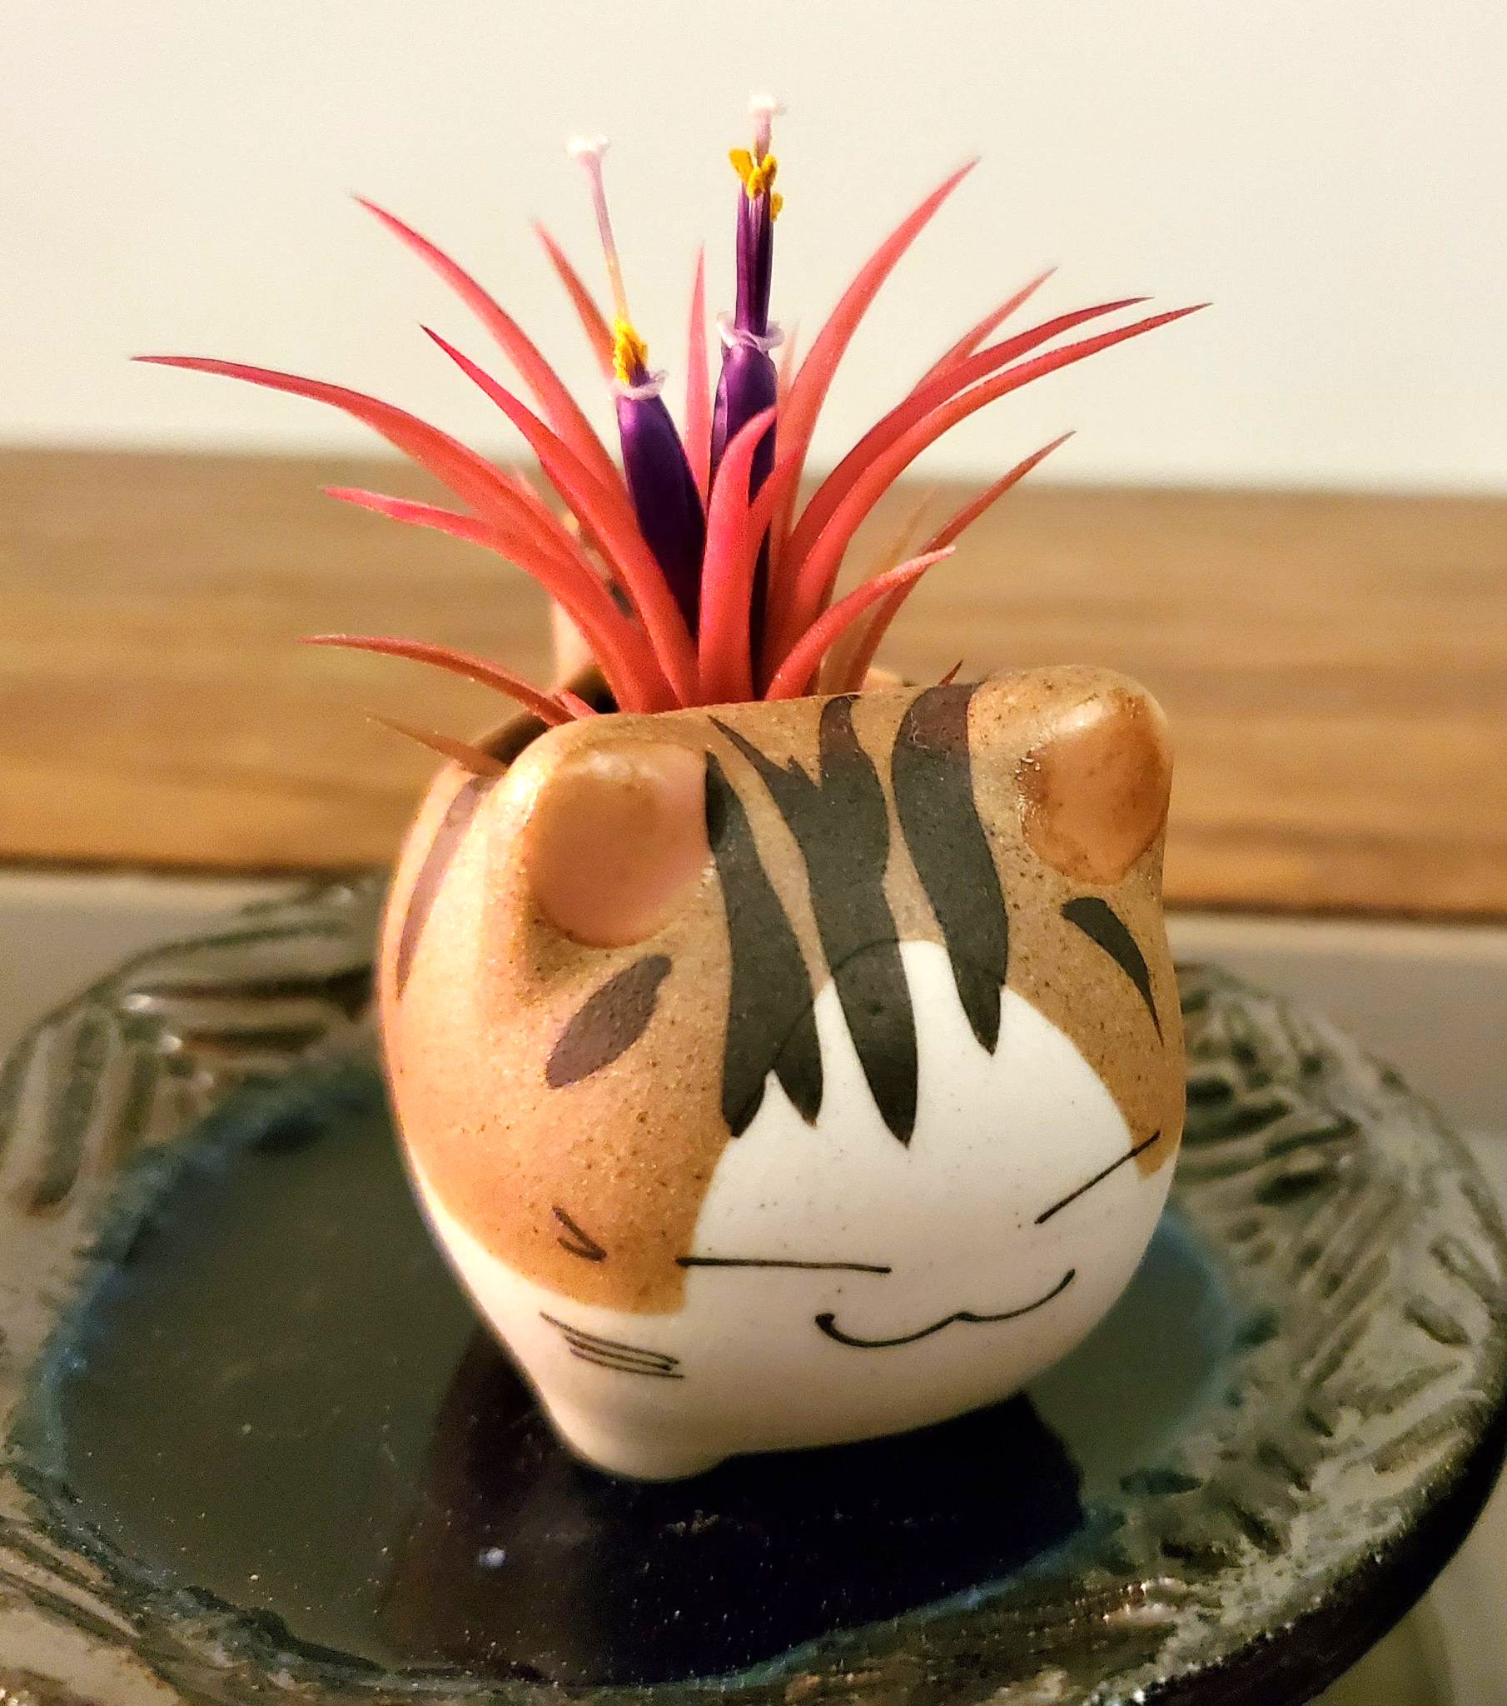
Increased Happiness
Horticultural therapy has shown to improve mental health conditions such as anxiety, loneliness, and depression [1]
Notes:
Studies, such as the one mentioned here, have shown that houseplants increase happiness and can even improve mental health

Slide 3
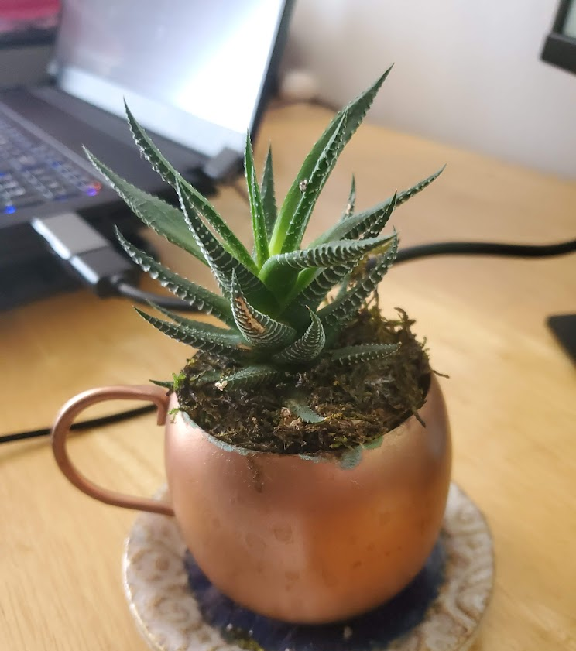
Increased Productivity
A review of studies between 1996 and 2017 found between 6-38% increase in productivity when an office had plants [2]
Notes:
If happiness isn’t enough, there is always productivity. A review of several studies found that including plants in the office increased productivity by some amount. This varied widely but the important takeaway is that none of the studies showed a decrease in productivity.

Slide 4
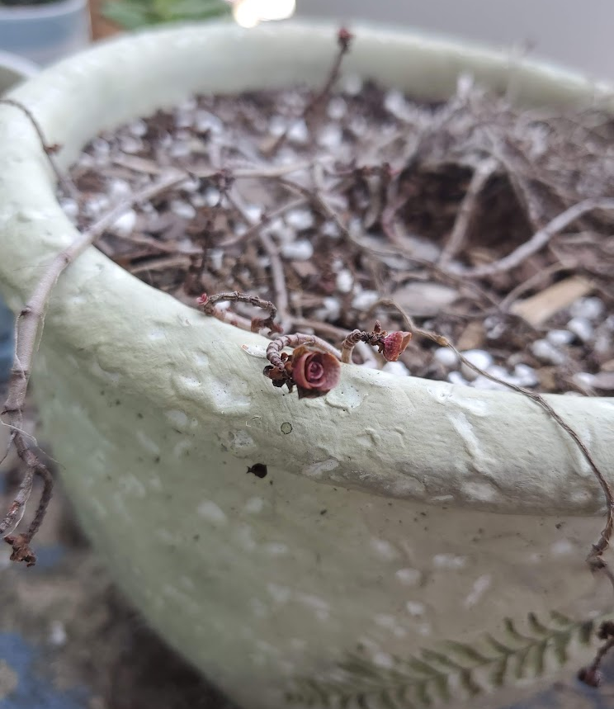
The Burden of Choice
Few people do not know the disappointment of adopting a houseplant only to have it die.
Water, light, and soil conditions can all affect your new friend.
Maybe you just need to choose the right plant, but how? There are so many to choose from!
Rosencrantz the Red Dragon’s Blood Succulent (deceased)
Notes:
So, plants are good, but how do you choose? Even the most experienced plant parent knows what it’s like to fail a plant. For example Rosencrantz, a beautiful Dragon’s Blood succulent that seemed to be on the brink of death for several months before finally giving it’s last gasps.
Succulents are supposed to be easy and I have several others that are thriving, so how can one choose a plant that is going to survive?

Slide 5
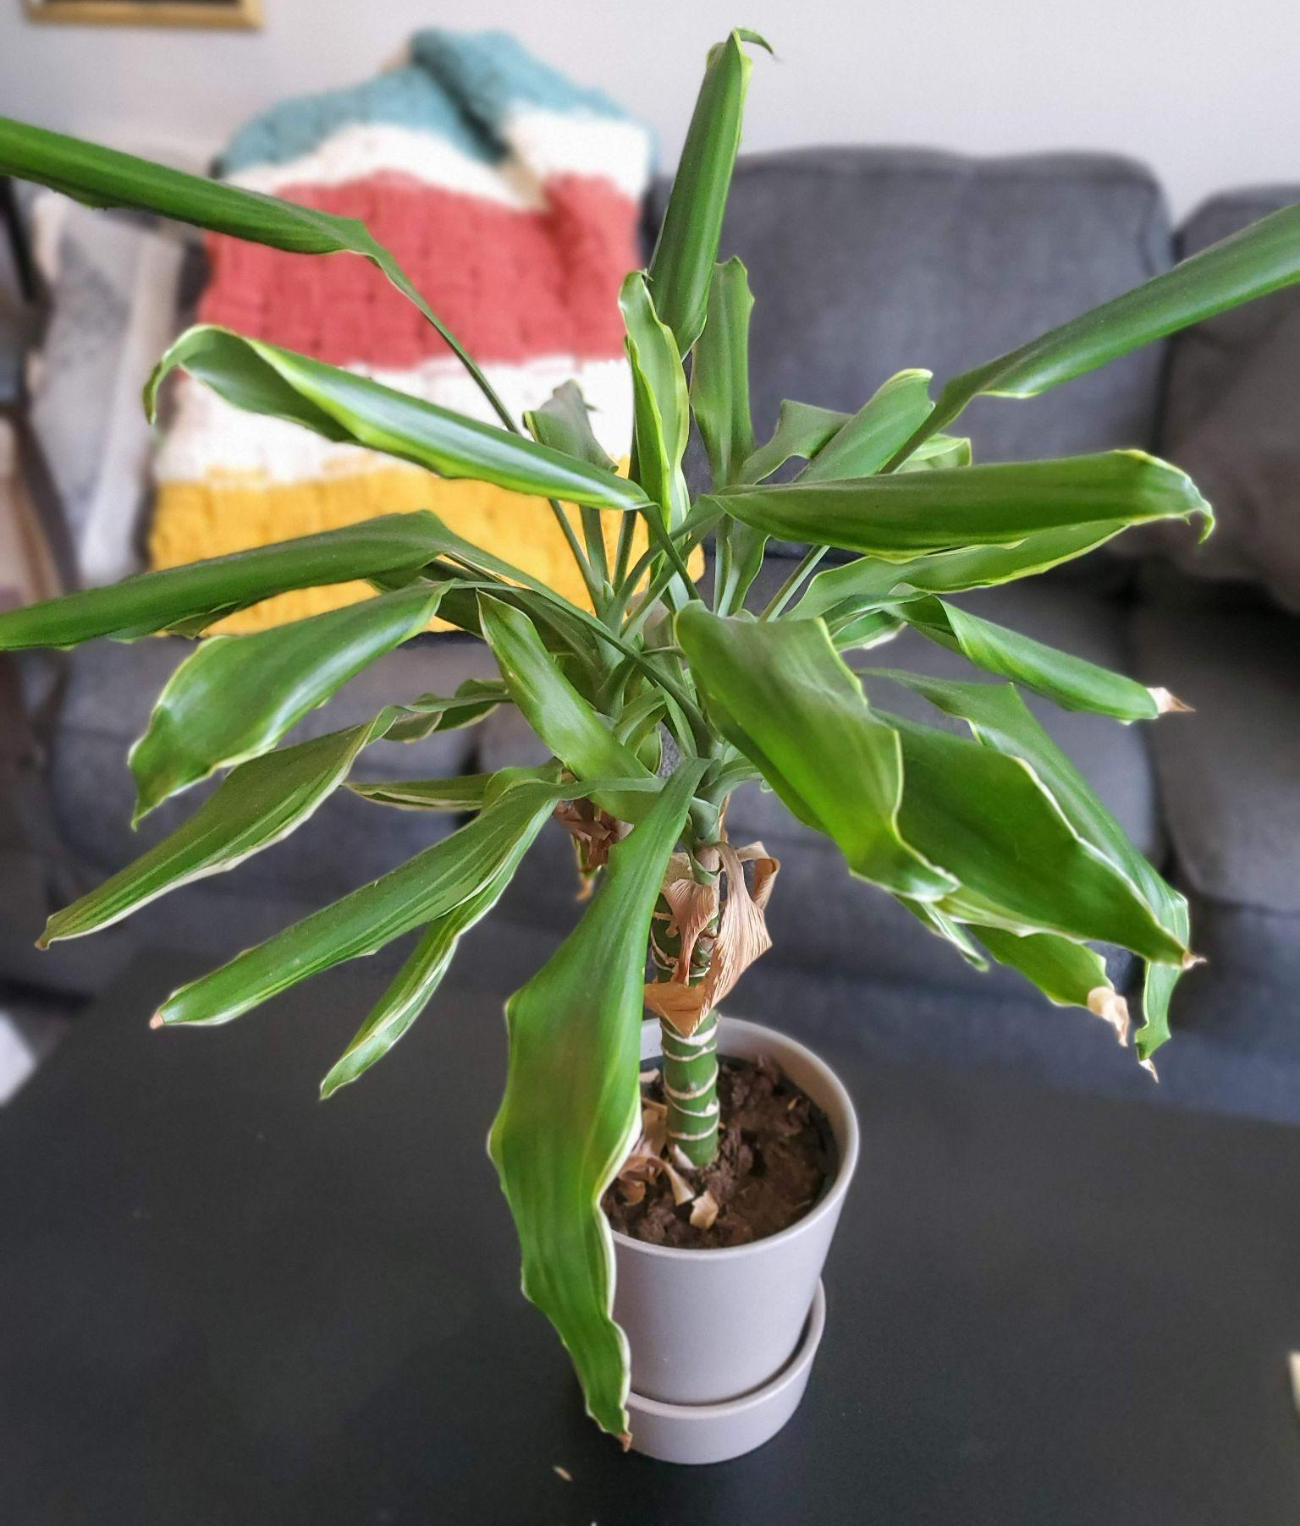
Violet’s House of Plants
Violet is opening a plant shop staged as a house with different levels of light in each “room” so that her customers can choose a plant based on the room it will be placed in their own house
Patio/Balcony - Full sun
Living Room - 50-75% minimum light, low to moderate watering
Office - 50-75% minimum light, neglect tolerant
Kitchen - 50-100% minimum light, high maintenance, high water
Bedroom - Low light, neglect tolerant
Minerva
Notes:
Well the truth of it is that there is no guarantee even if you choose wisely. However, what if a shop at least made the choosing easier?
This hypothetical plant shop, owned by Violet, will be set up to mimic different conditions that a houseplant might encounter.
Therefore you, the customer, can simply go to the room in the store which best fits the room in your house or office to select a plant.
These are the conditions for each room.
For example an office plant would need to be neglect tolerant, in case the one person watering goes on vacation or in the case where everyone assumes someone else is watering it!

Slide 6
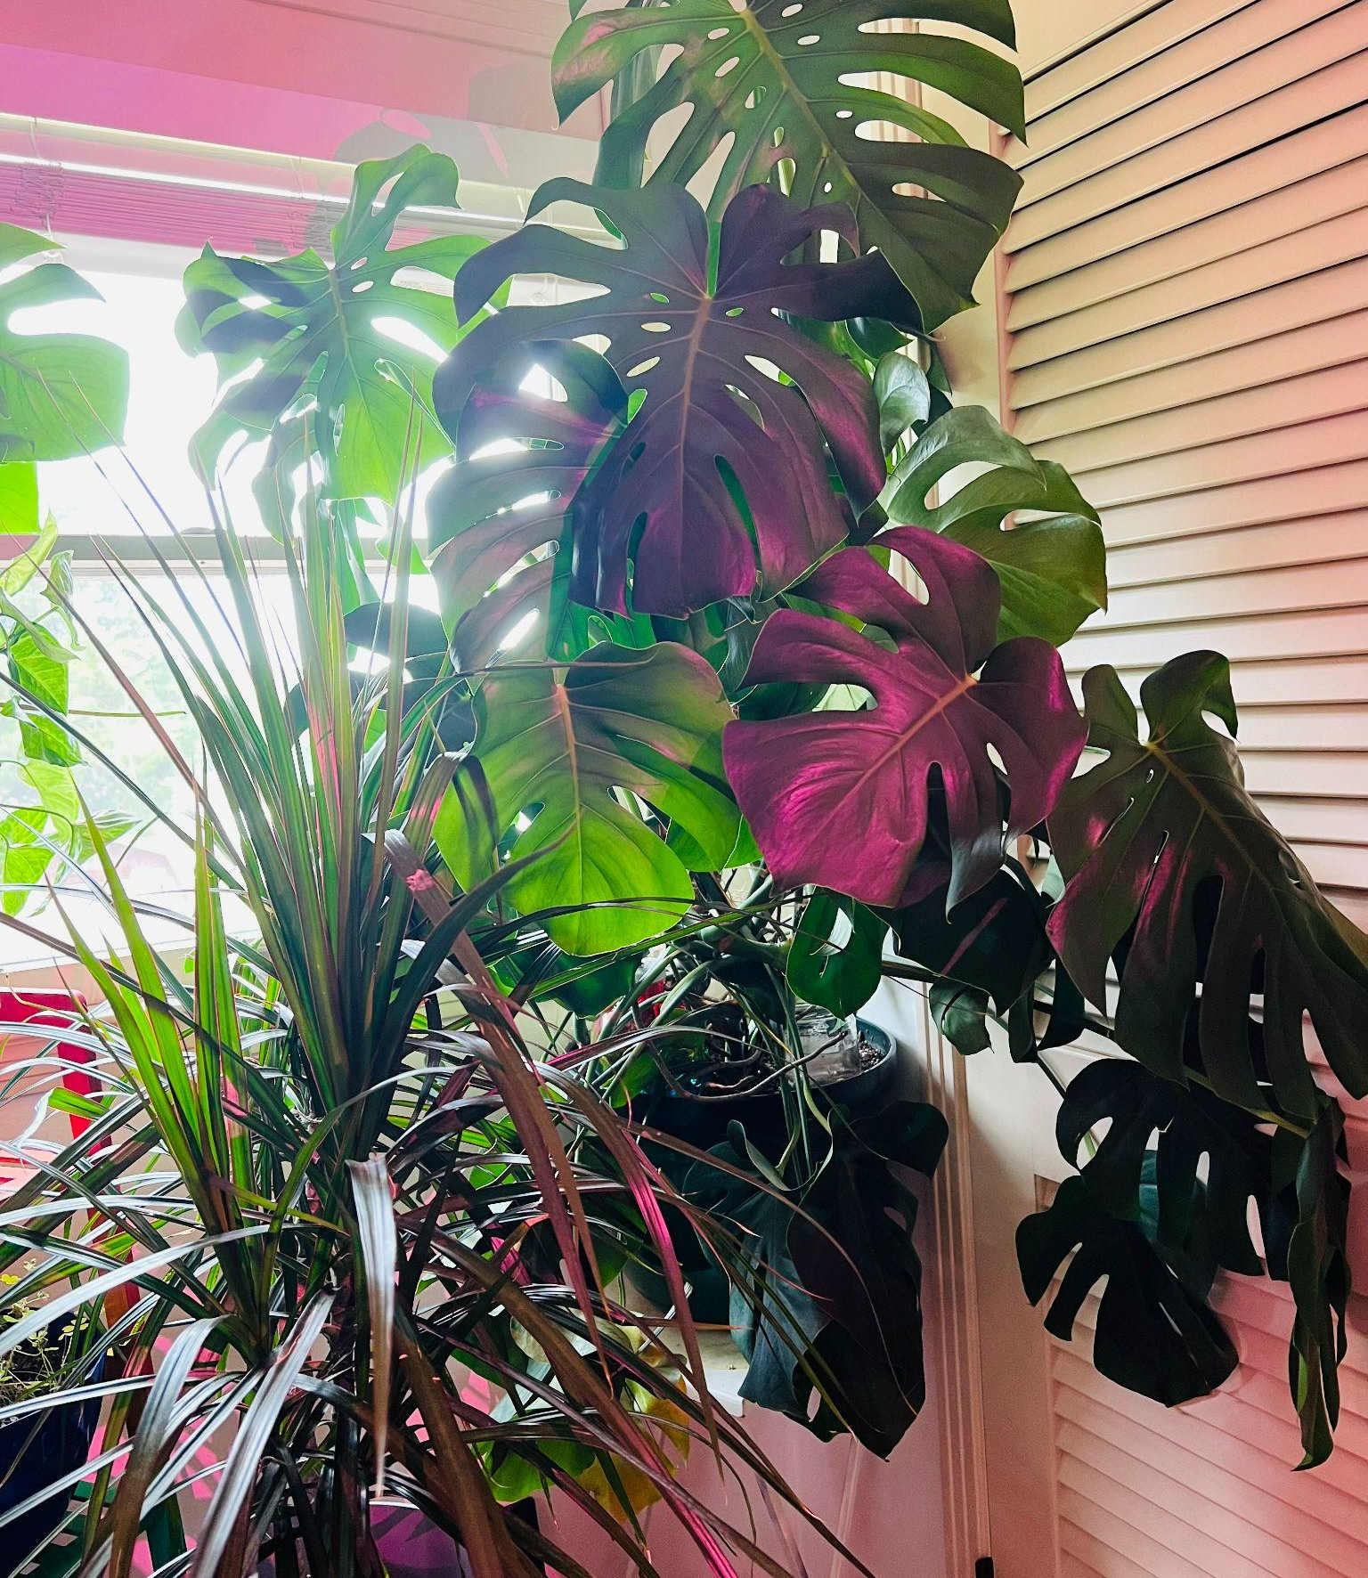
Analysis
Violet would like the following:
How much room is needed for each room
How much of each soil type to order
How much of each soil mix to make
How many “Toxic”, “High Maintenance”, and “Tolerates Neglect” signs to order
How many of each pot size to order
A tool to help customers search for plants
June the Monstera
Notes:
The analysis Violet wants to open her shop are
How much room will be needed for each room so she can start scouting locations
How much of each soil type to order and how much of each recipe to make.
How many Toxic or High maintenance signs, and pots of each size to order
A tool to help customers or staff find plants that will be a good fit for them

Slide 7
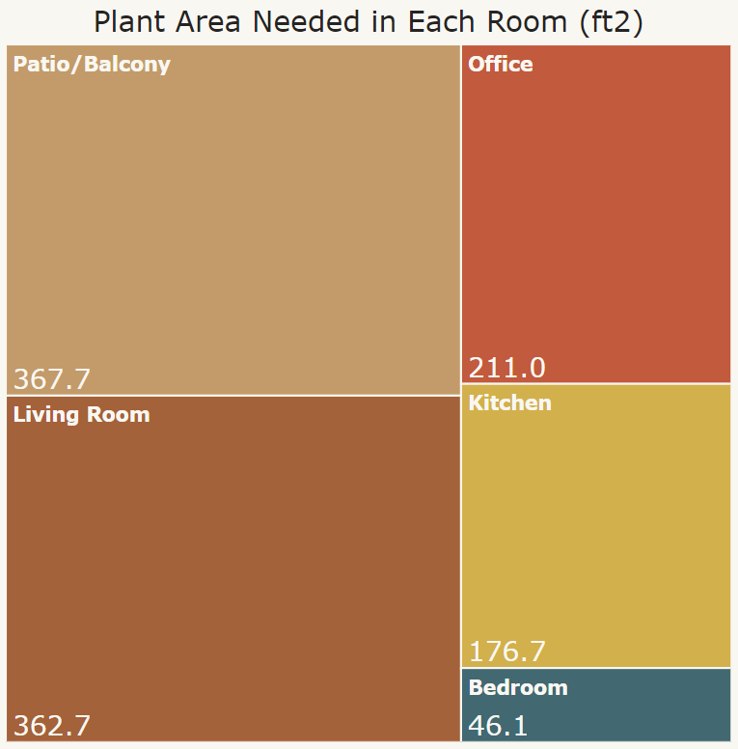
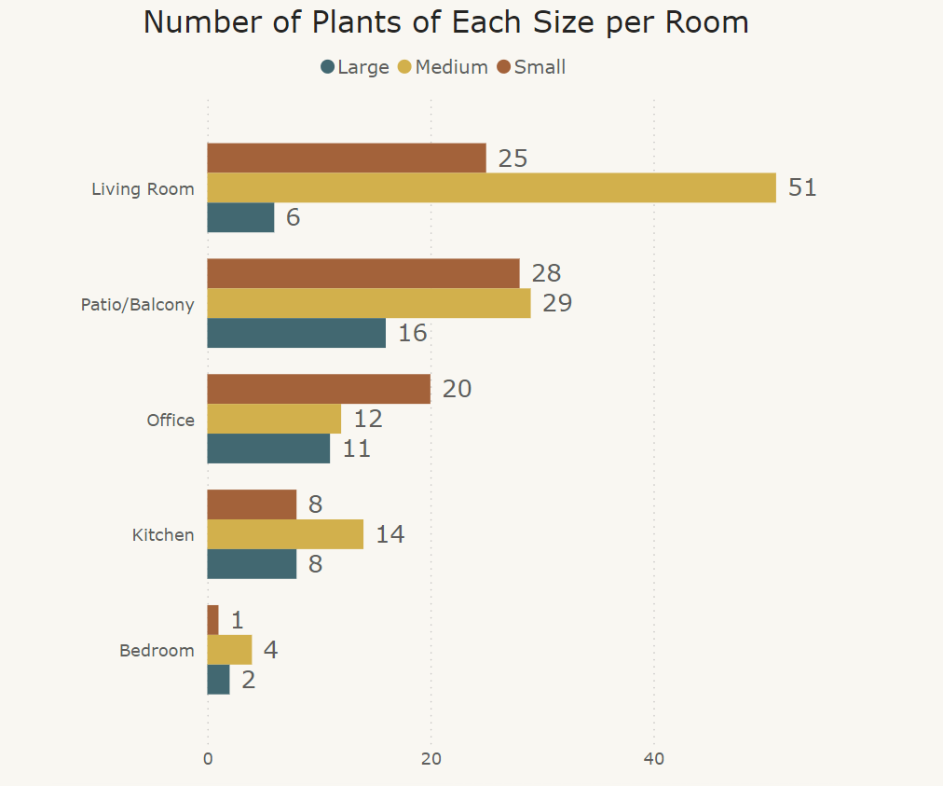
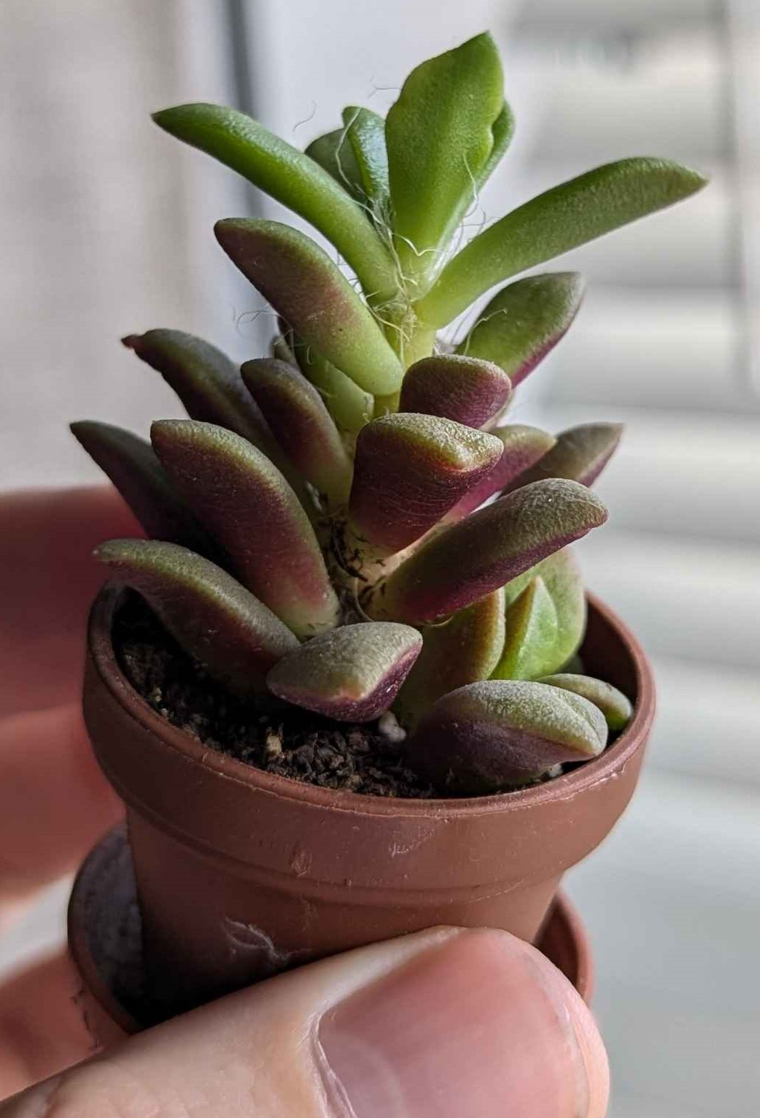
Plant Area Needed
Notes:
So first we have How much area is needed for each of the rooms.
Here we have the relative area of each room with a rough estimate in square feet on how much space all the plants intended for that room will take up.
Then on the right we have how many of each size of plant will be in each room so that she can figure out how many shelves will need to fit in the room.
With this Violet can start scouting possible locations.

Slide 8

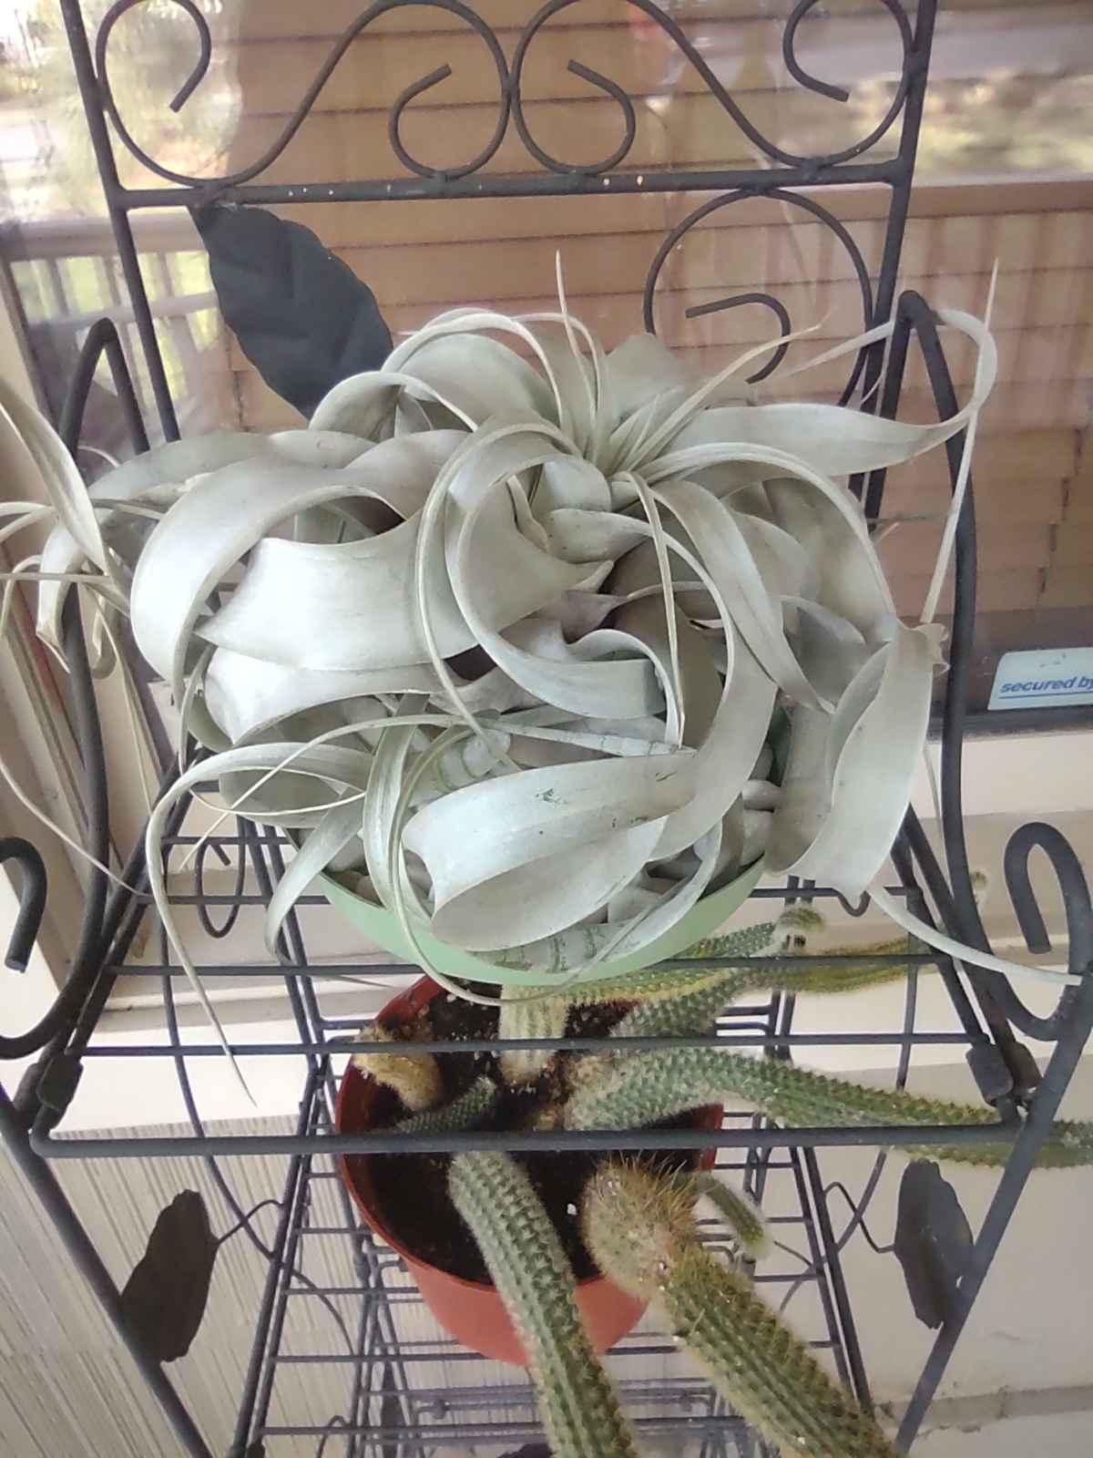
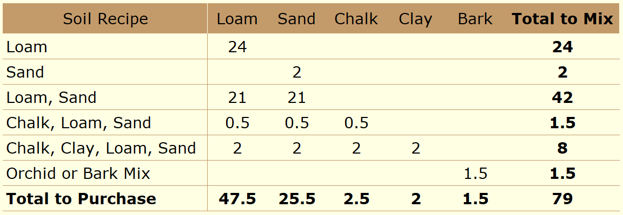
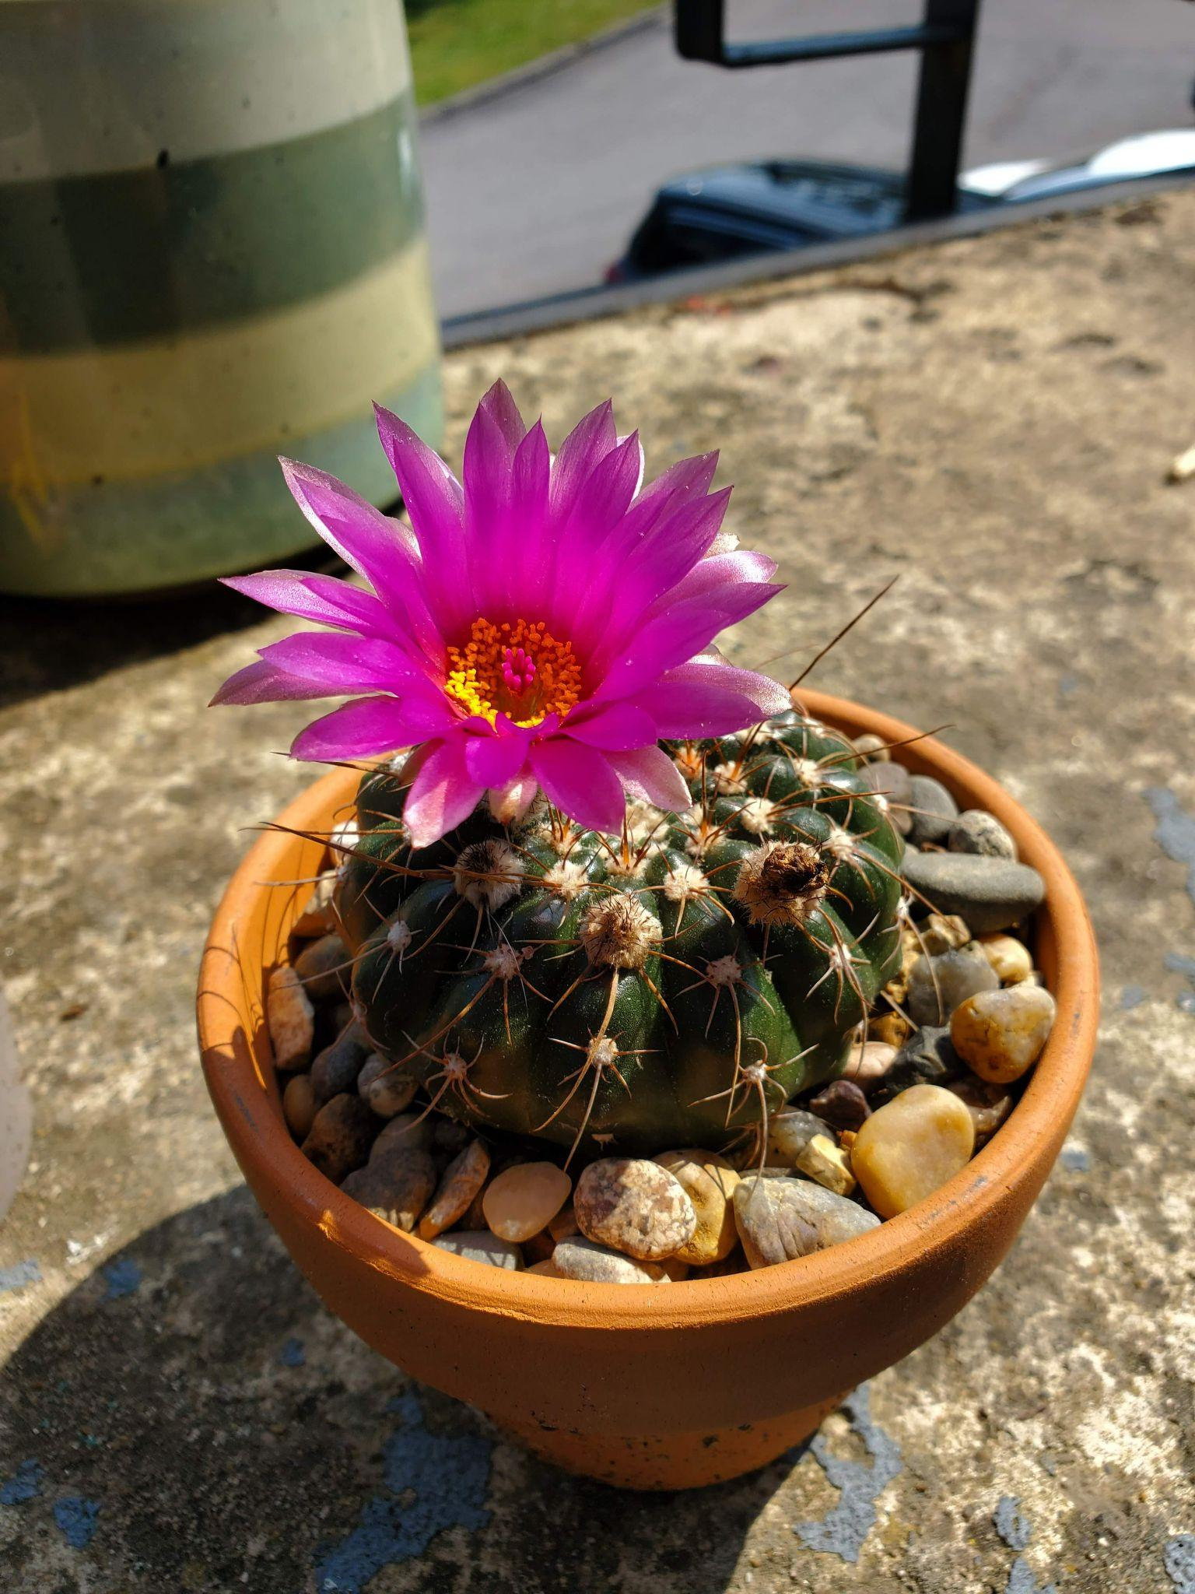
Soil
All plants need well-drained soil
Well-drained does not mean dry, some soils hold water better than others and will remain moist but not soggy. Some plants will need soil that not only drains well but also dries out. Epiphytic plants prefer practically no soil at all!
Luffy
Stacy
Notes:
In the meantime soil can be sourced.
All plants need well drained soil. If they need soil at all. On the top left is an air plant that needs no soil at all.
For the rest of the plants we have the calculations for how many cubic feet to buy for each type as well as the amount of each recipe to mix up.
This is calculated with a slight over estimate so that any extra can be sold as custom soil mixes alongside the plants.

Slide 9
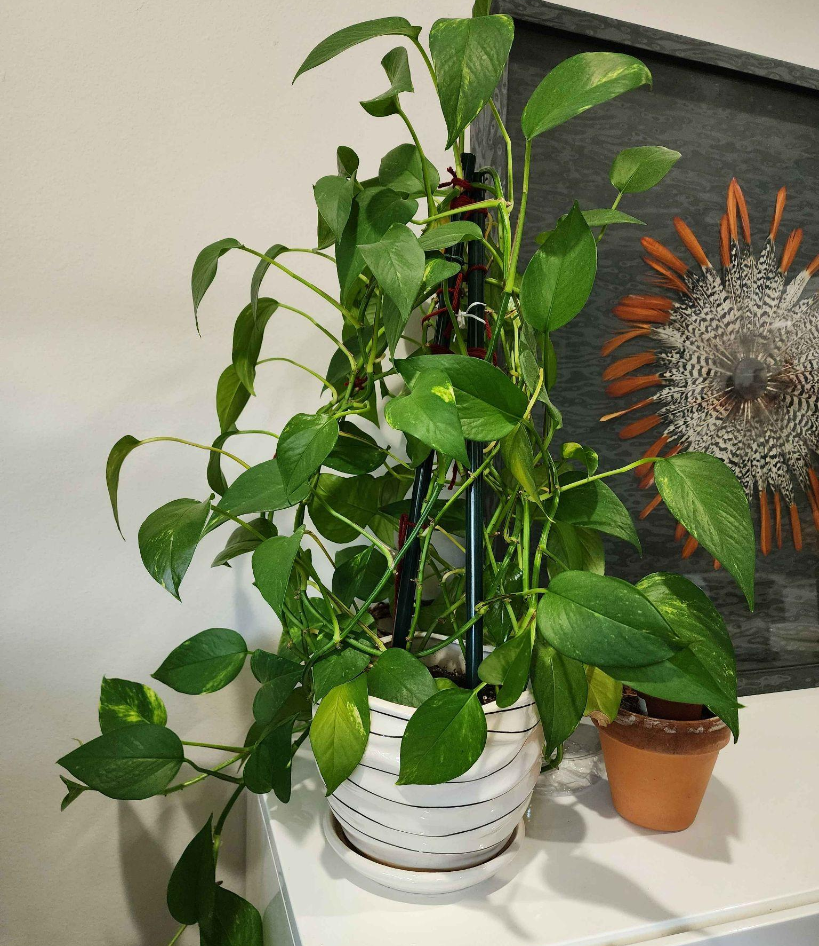
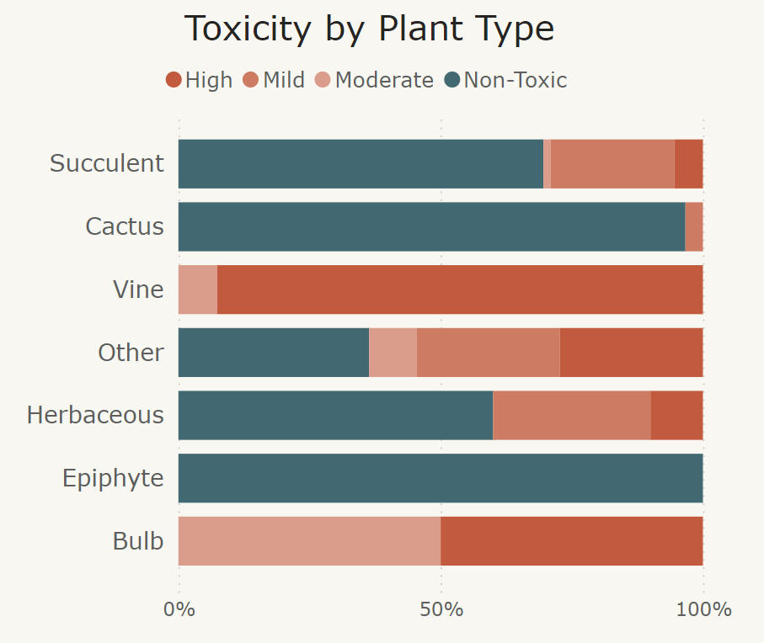
Total Toxic Plants: 86
June the Pothos (Toxic)
Notes:
Next up is a assessment of the toxicity of different plant types. All vines and bulbs in the shop have some amount of toxicity and all Epiphytes offered are non-toxic.
Which is really convenient since it is difficult to stick a sign in a pot without any soil. The other types are mixed so we’ll need to make sure the signs stand out.

Slide 10
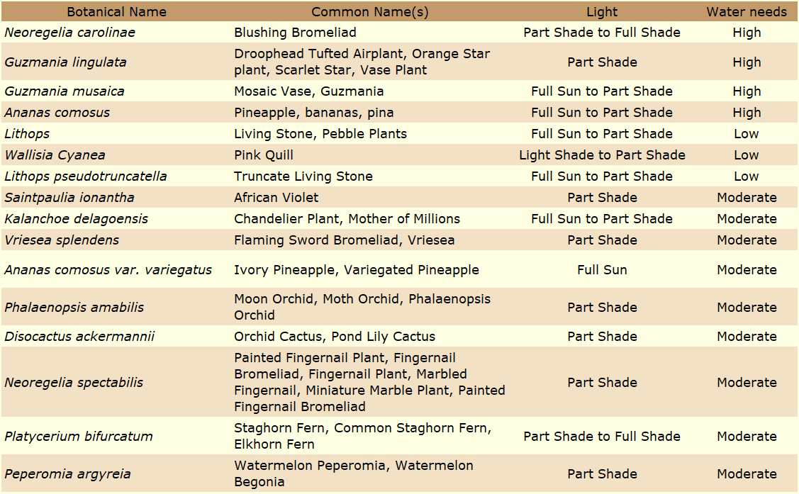
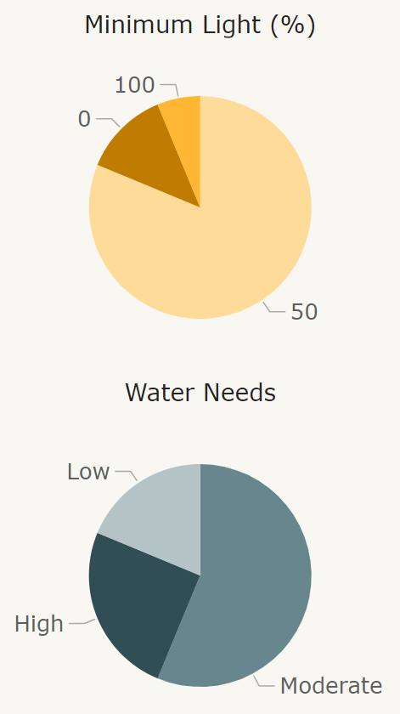
High Maintenance Plants: 16
High Maintenance Plant Requirements
Notes:
There are 16 plants that require high maintenance relative to the other plants in the shop.
This was determined based on how much watering they needed as well as how finicky they were about when and how they got that water.
Other factors about care were also considered. Such as for the Lithops here which behaves in a manner that may throw off a beginner.
It’s old leaves will die off naturally as the new leaves grow in which can lead someone to conclude that the plant is dying and needs more water which leads to overwatering and the plant actually dying.
All of these are destined for the same room, the “Kitchen”, to make it easier for the staff. Also because this room is more frequented in most homes and as easily accessed water.

Slide 11
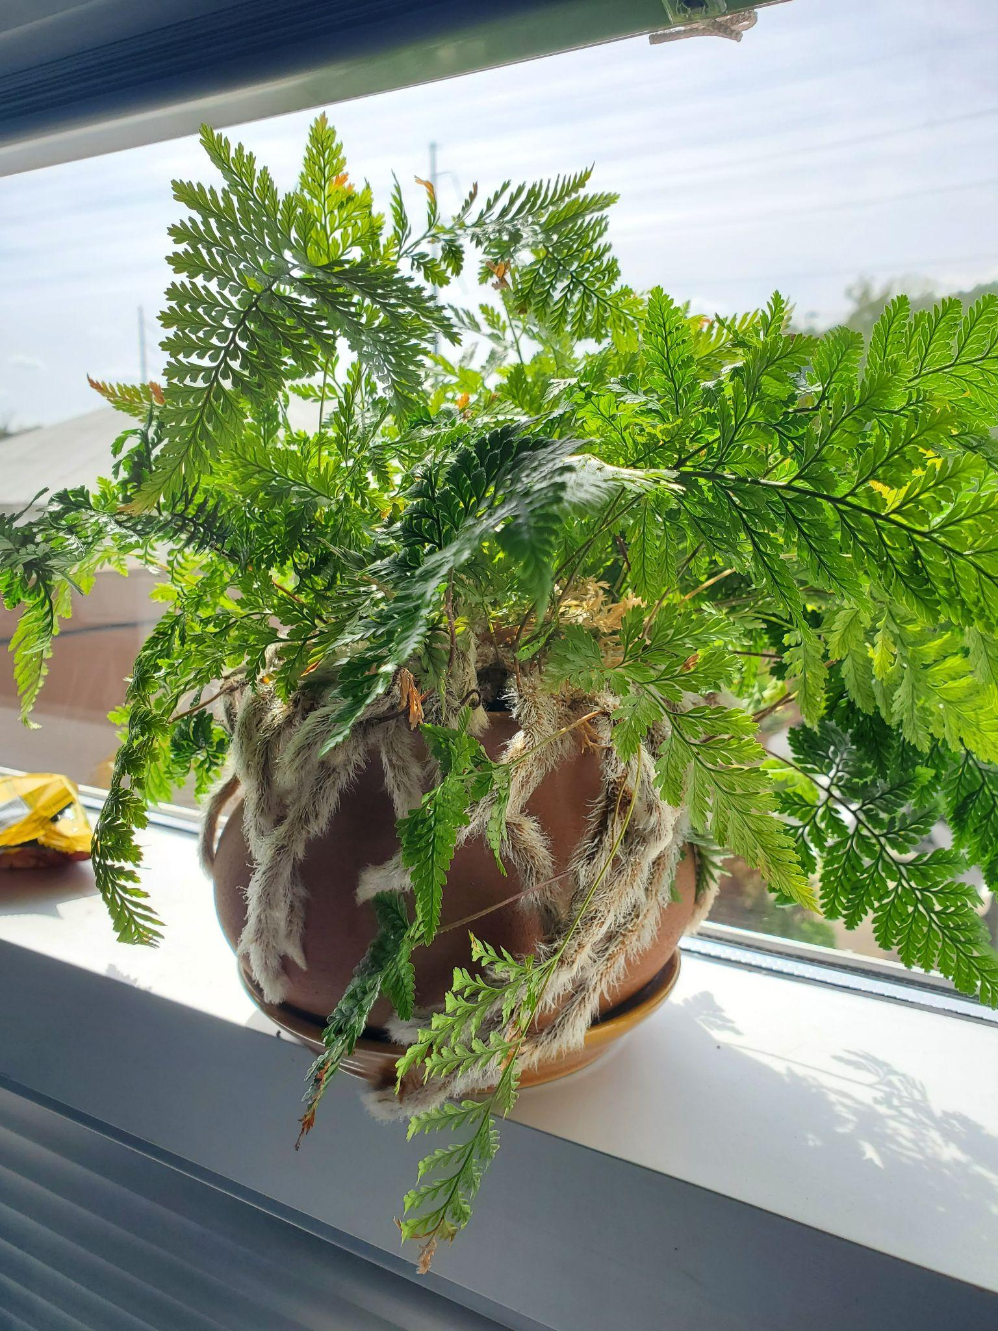
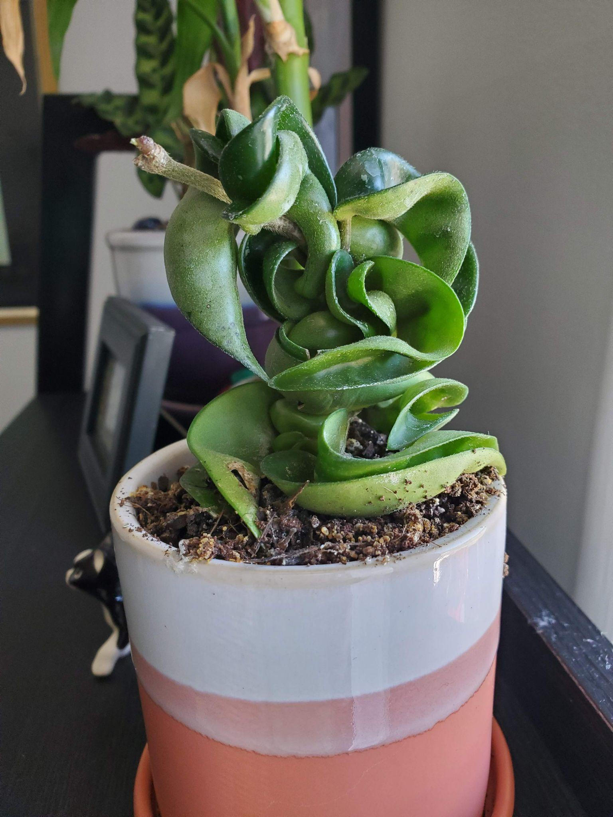
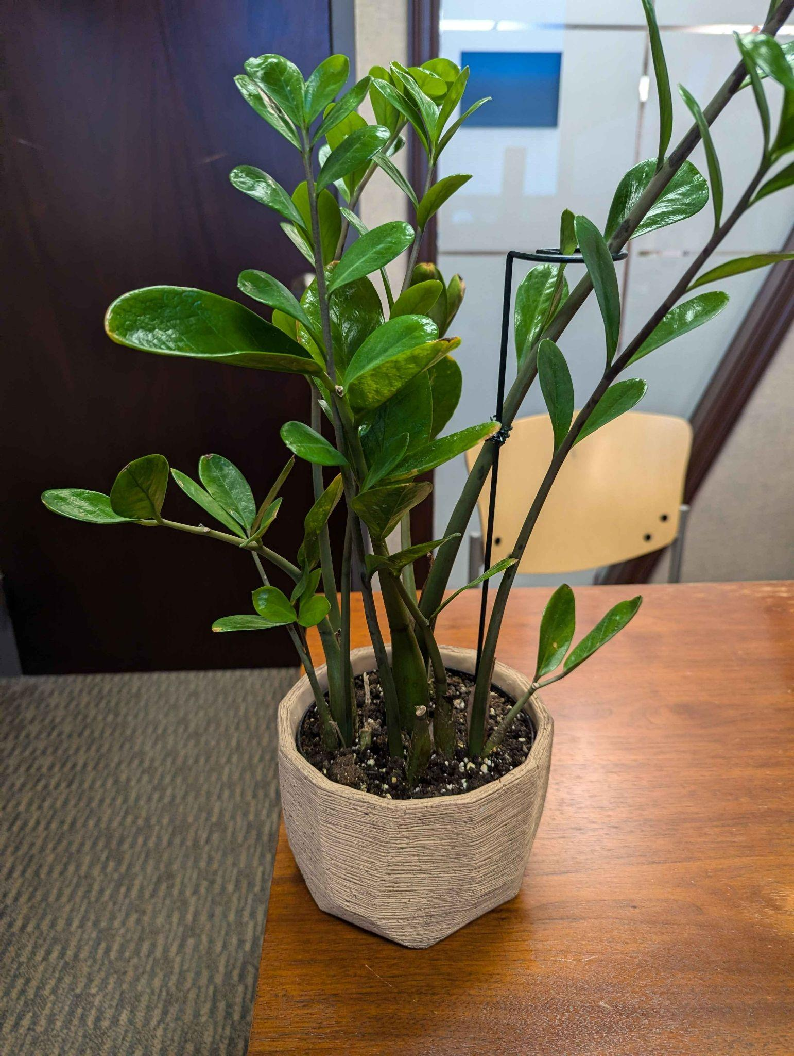
Neglect Tolerant: 196
Drought tolerant and low maintenance plants make for great office and beginner plants.
Steve
Aaron
Vernon “Verny” the Fern
Notes:
Next we have our plants that are the opposite, those that tolerate neglect. This is based mostly on whether or not the plant is drought tolerant.
196 of the 235 plants in Violet’s shop fit this description.

Slide 12
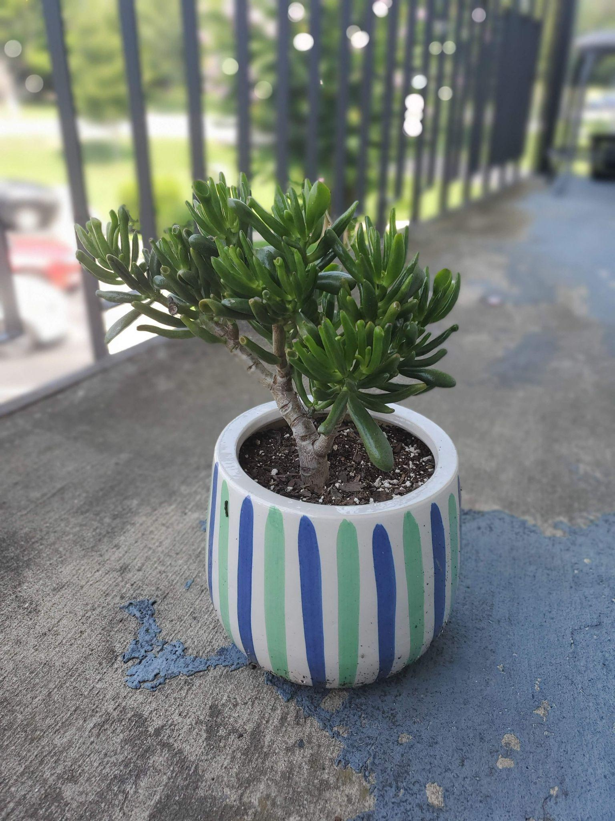
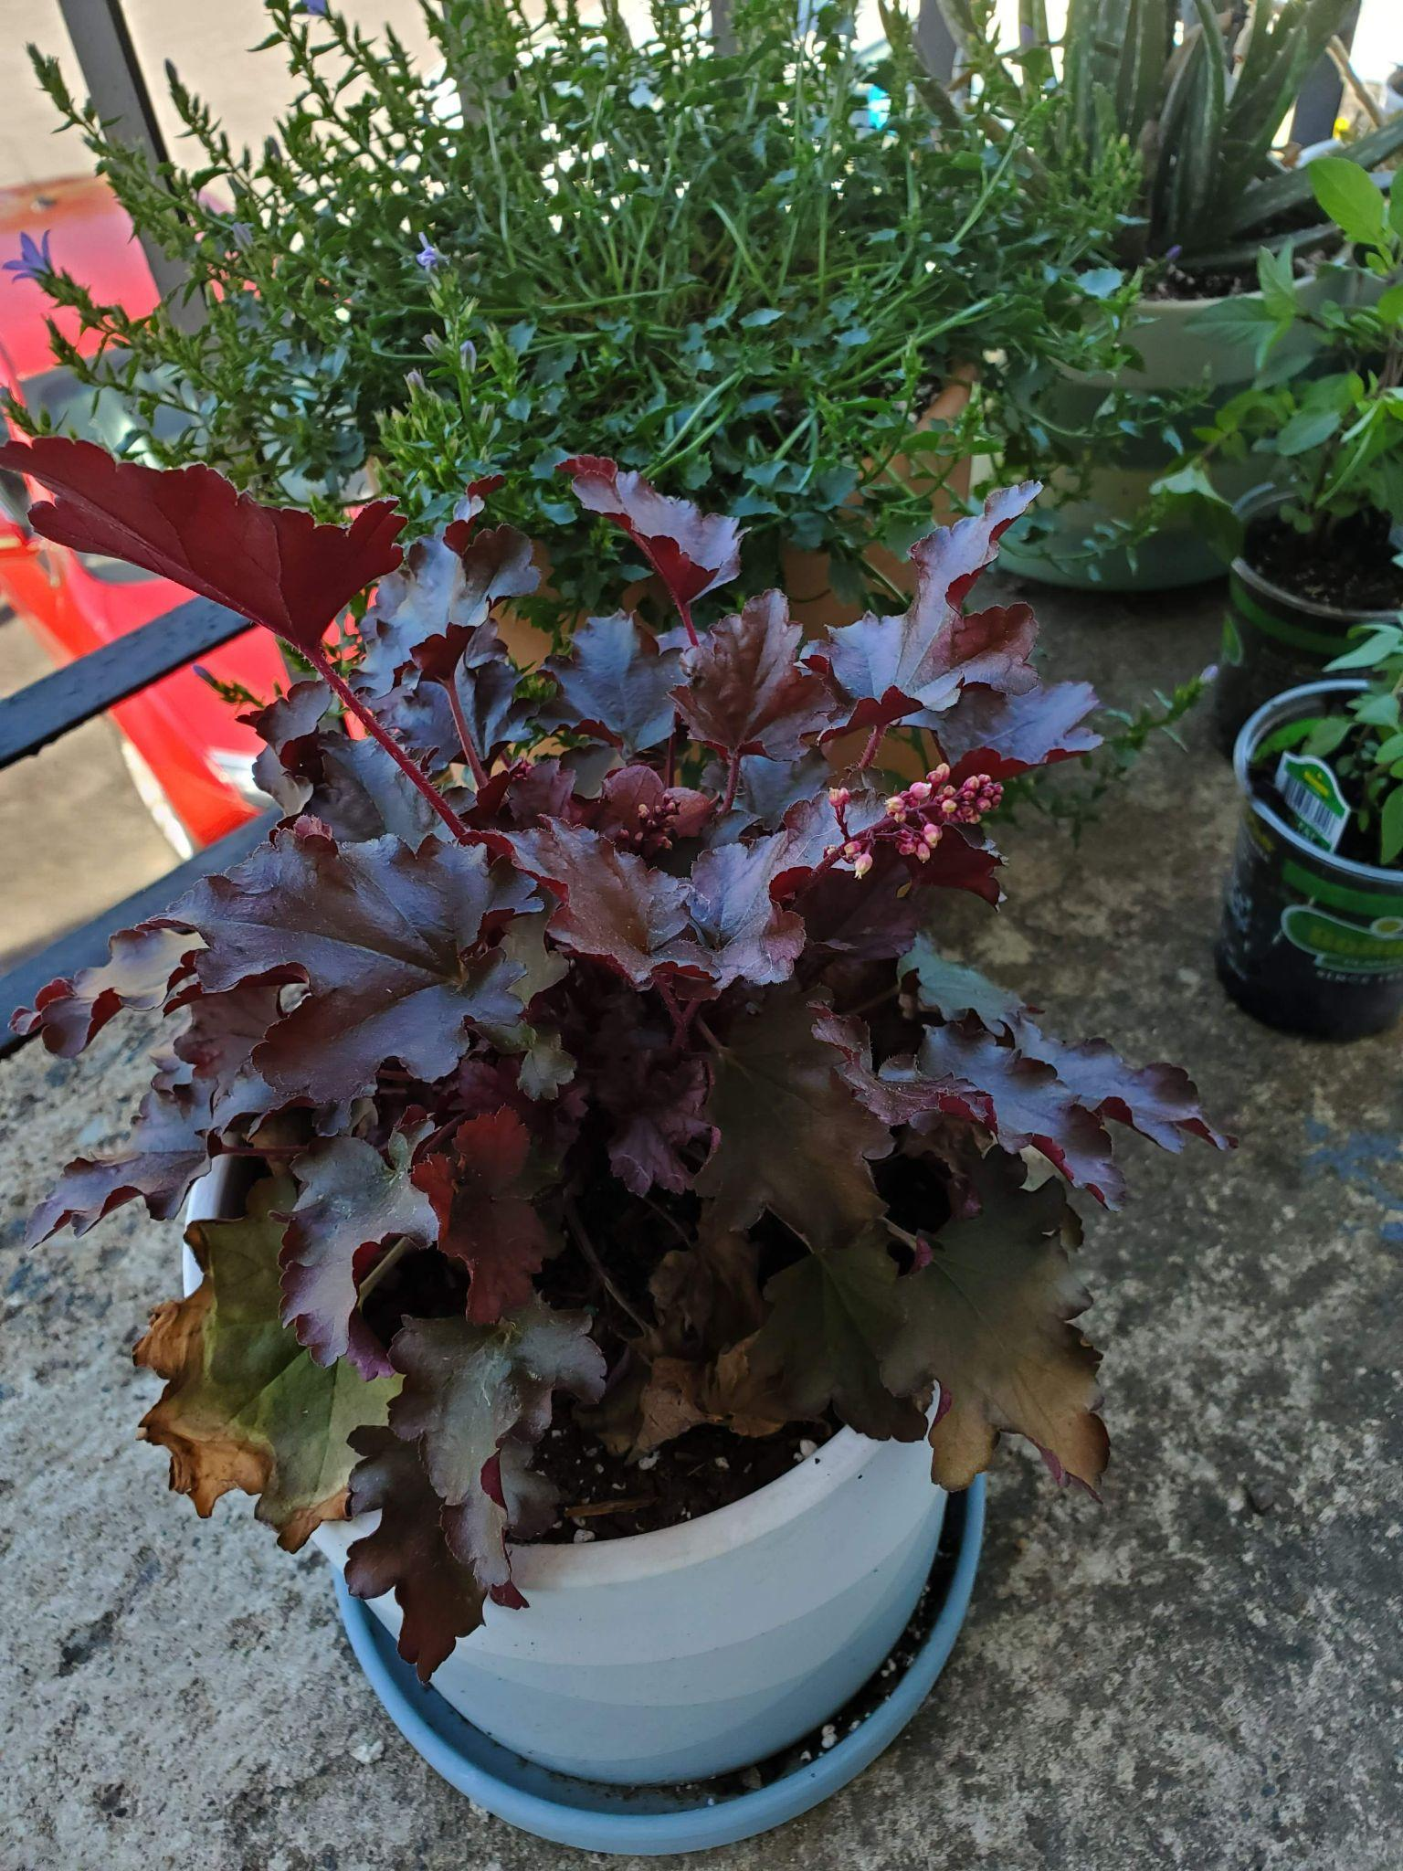
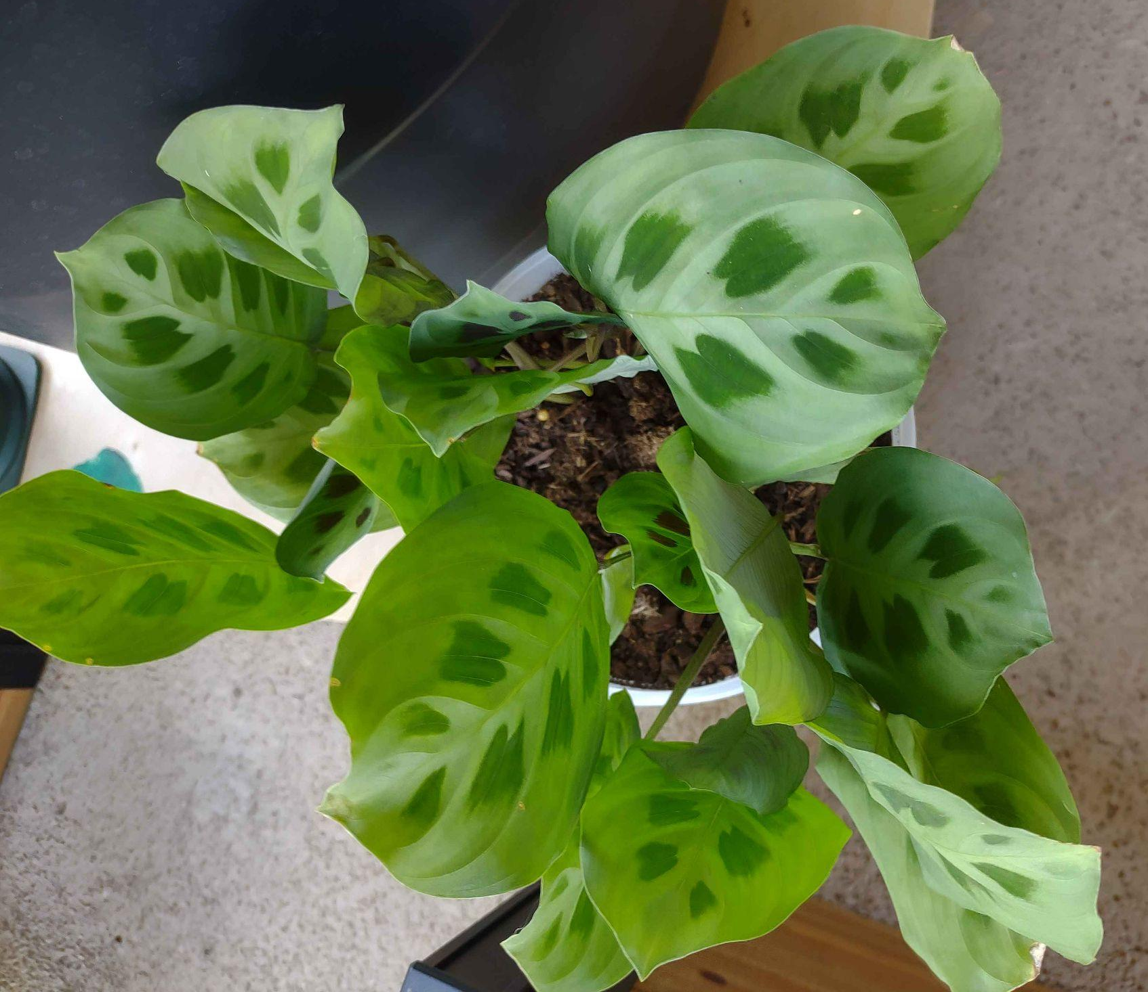
Total Supplies Needed
Soil (ft3)
Pots
Signs
47.5 Loamy
25.5 Sandy
2.5 Chalky
2.0 Clay
1.5 Orchid or Bark Mix
82 Small
110 Medium
43 Large
16 High Maintenance
86 Toxic
196 Neglect Tolerant
Majora
Gir
Ariel
Notes:
Now that we have all the supplies needed, there is one thing left.

Slide 13
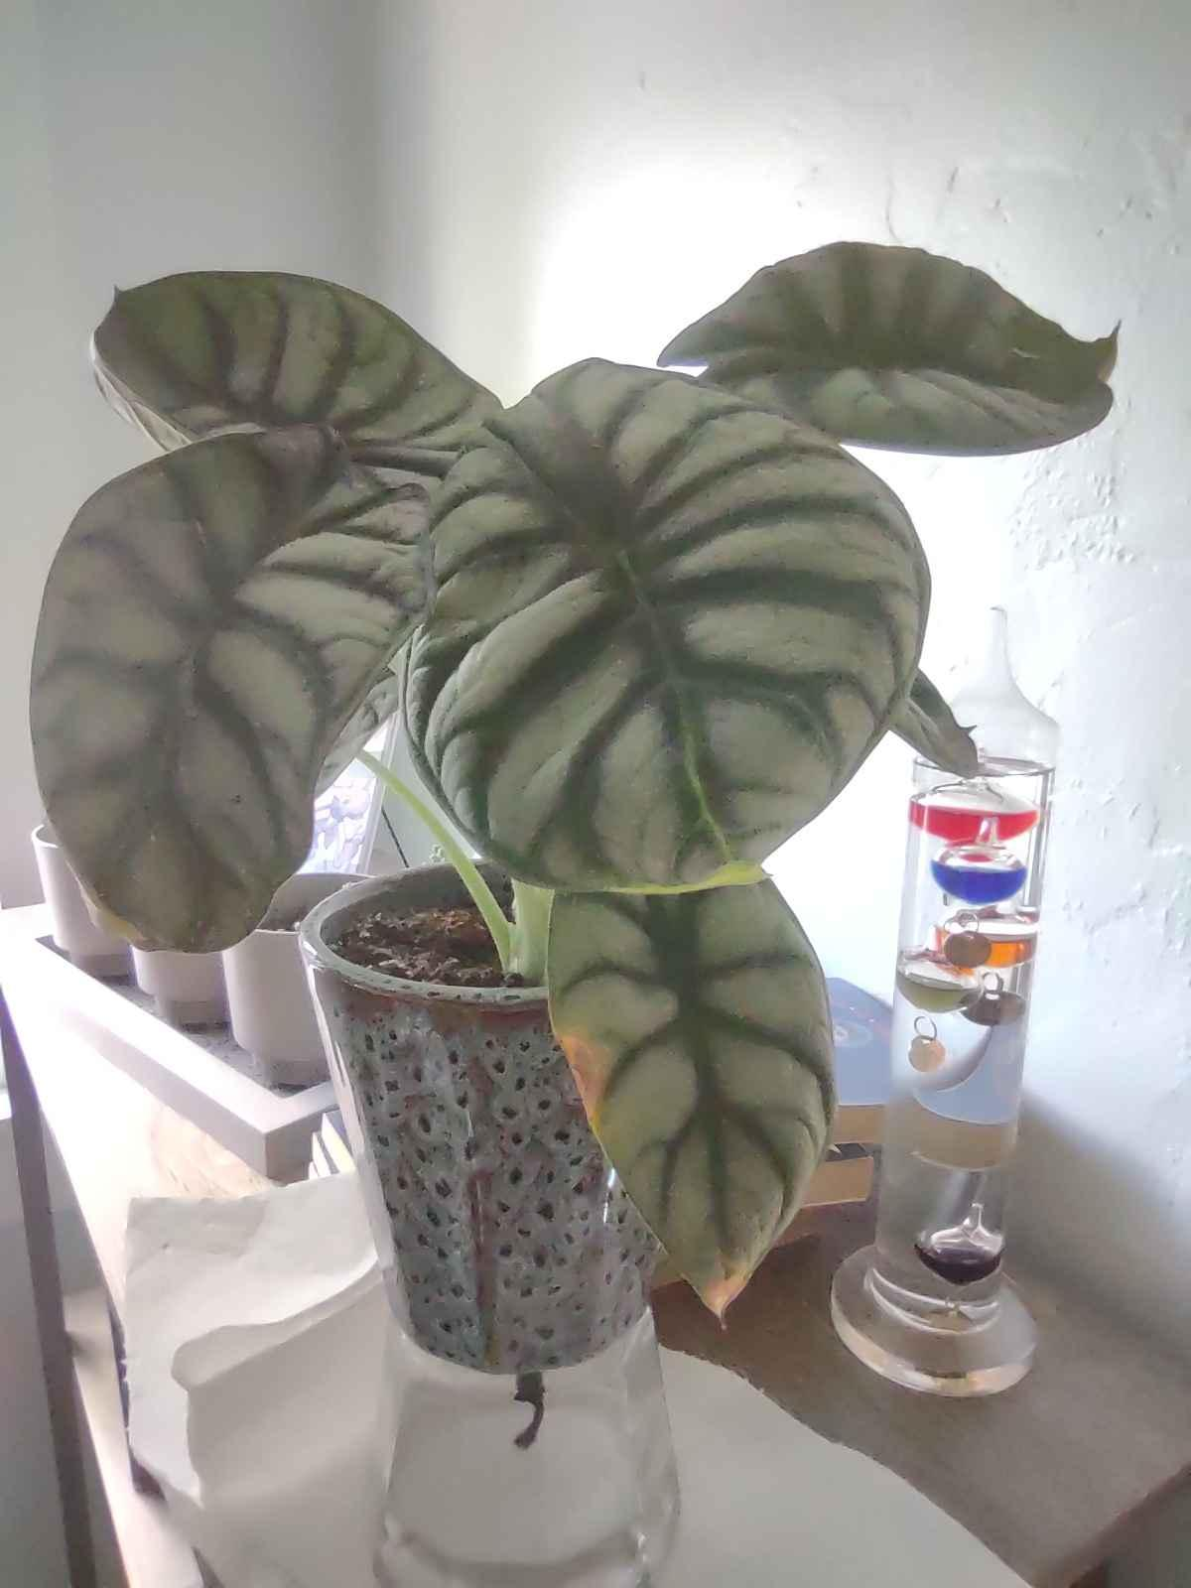
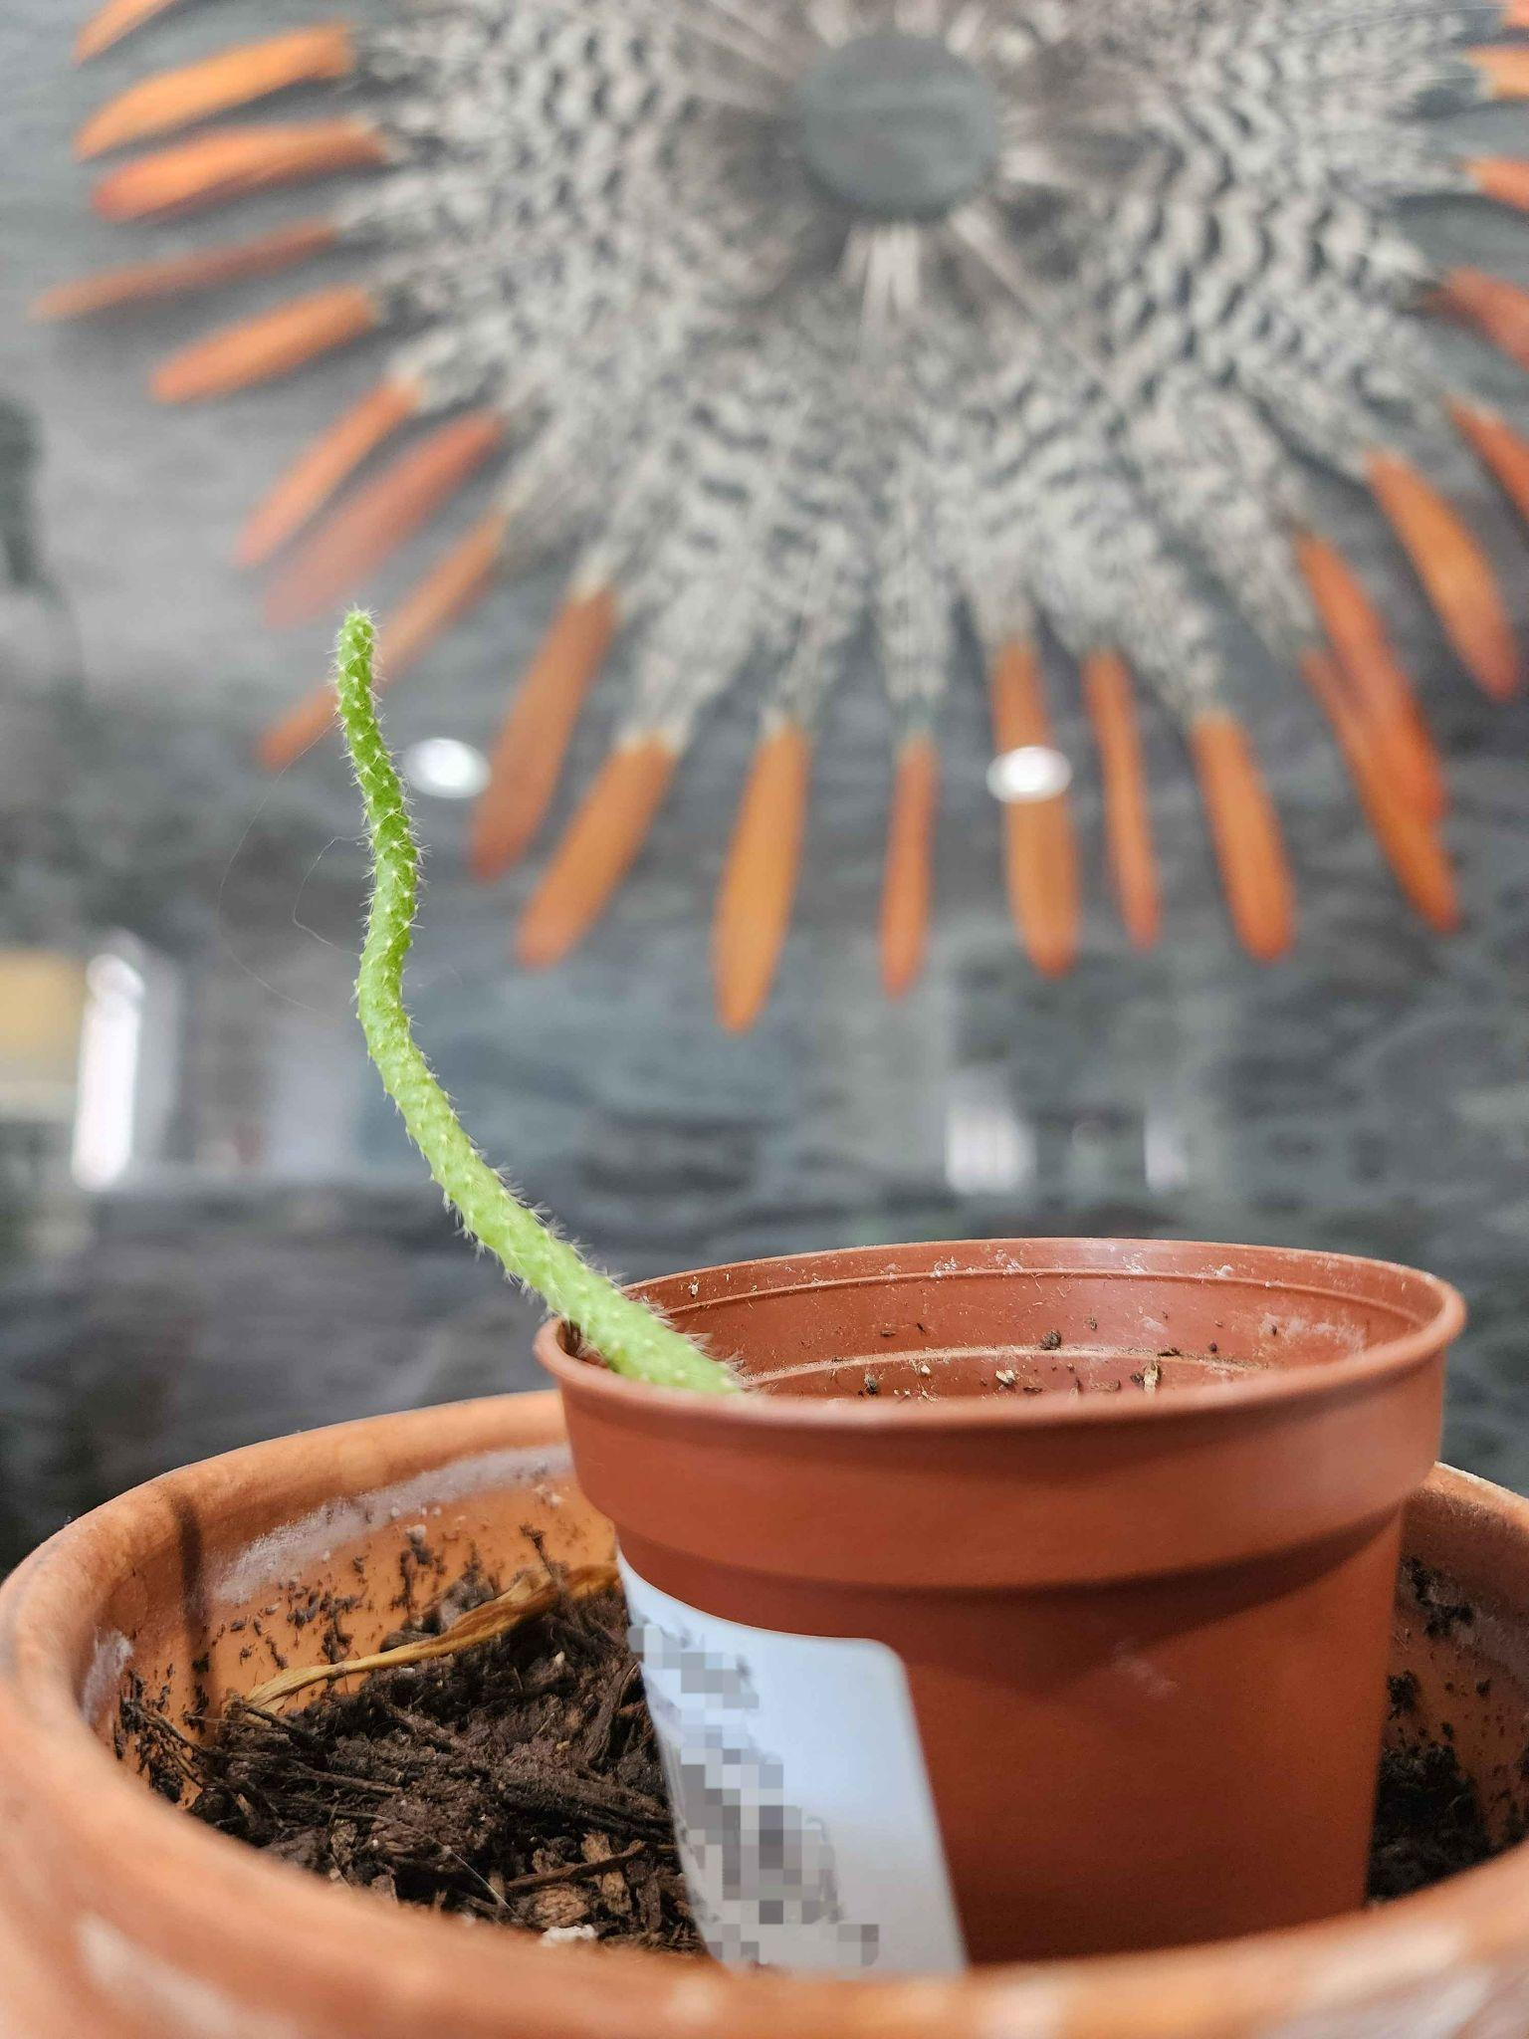
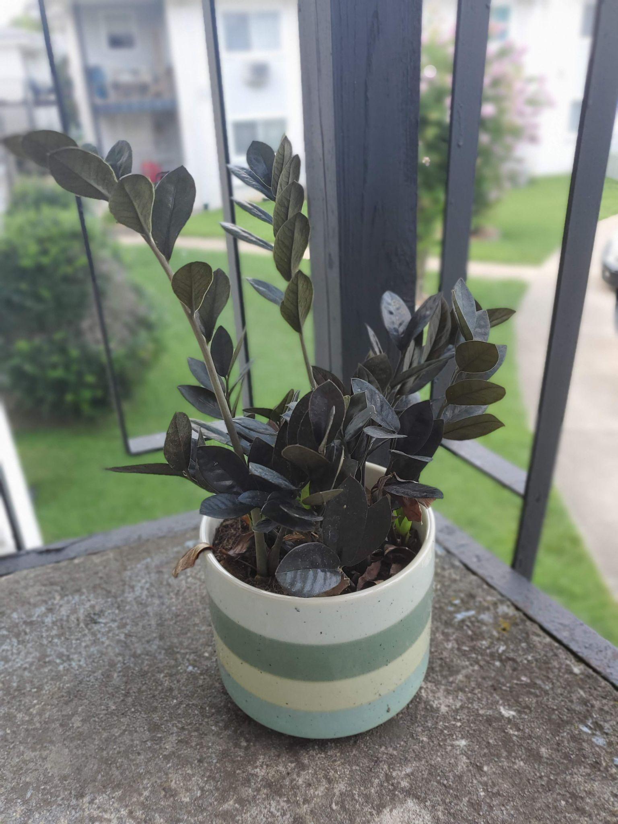
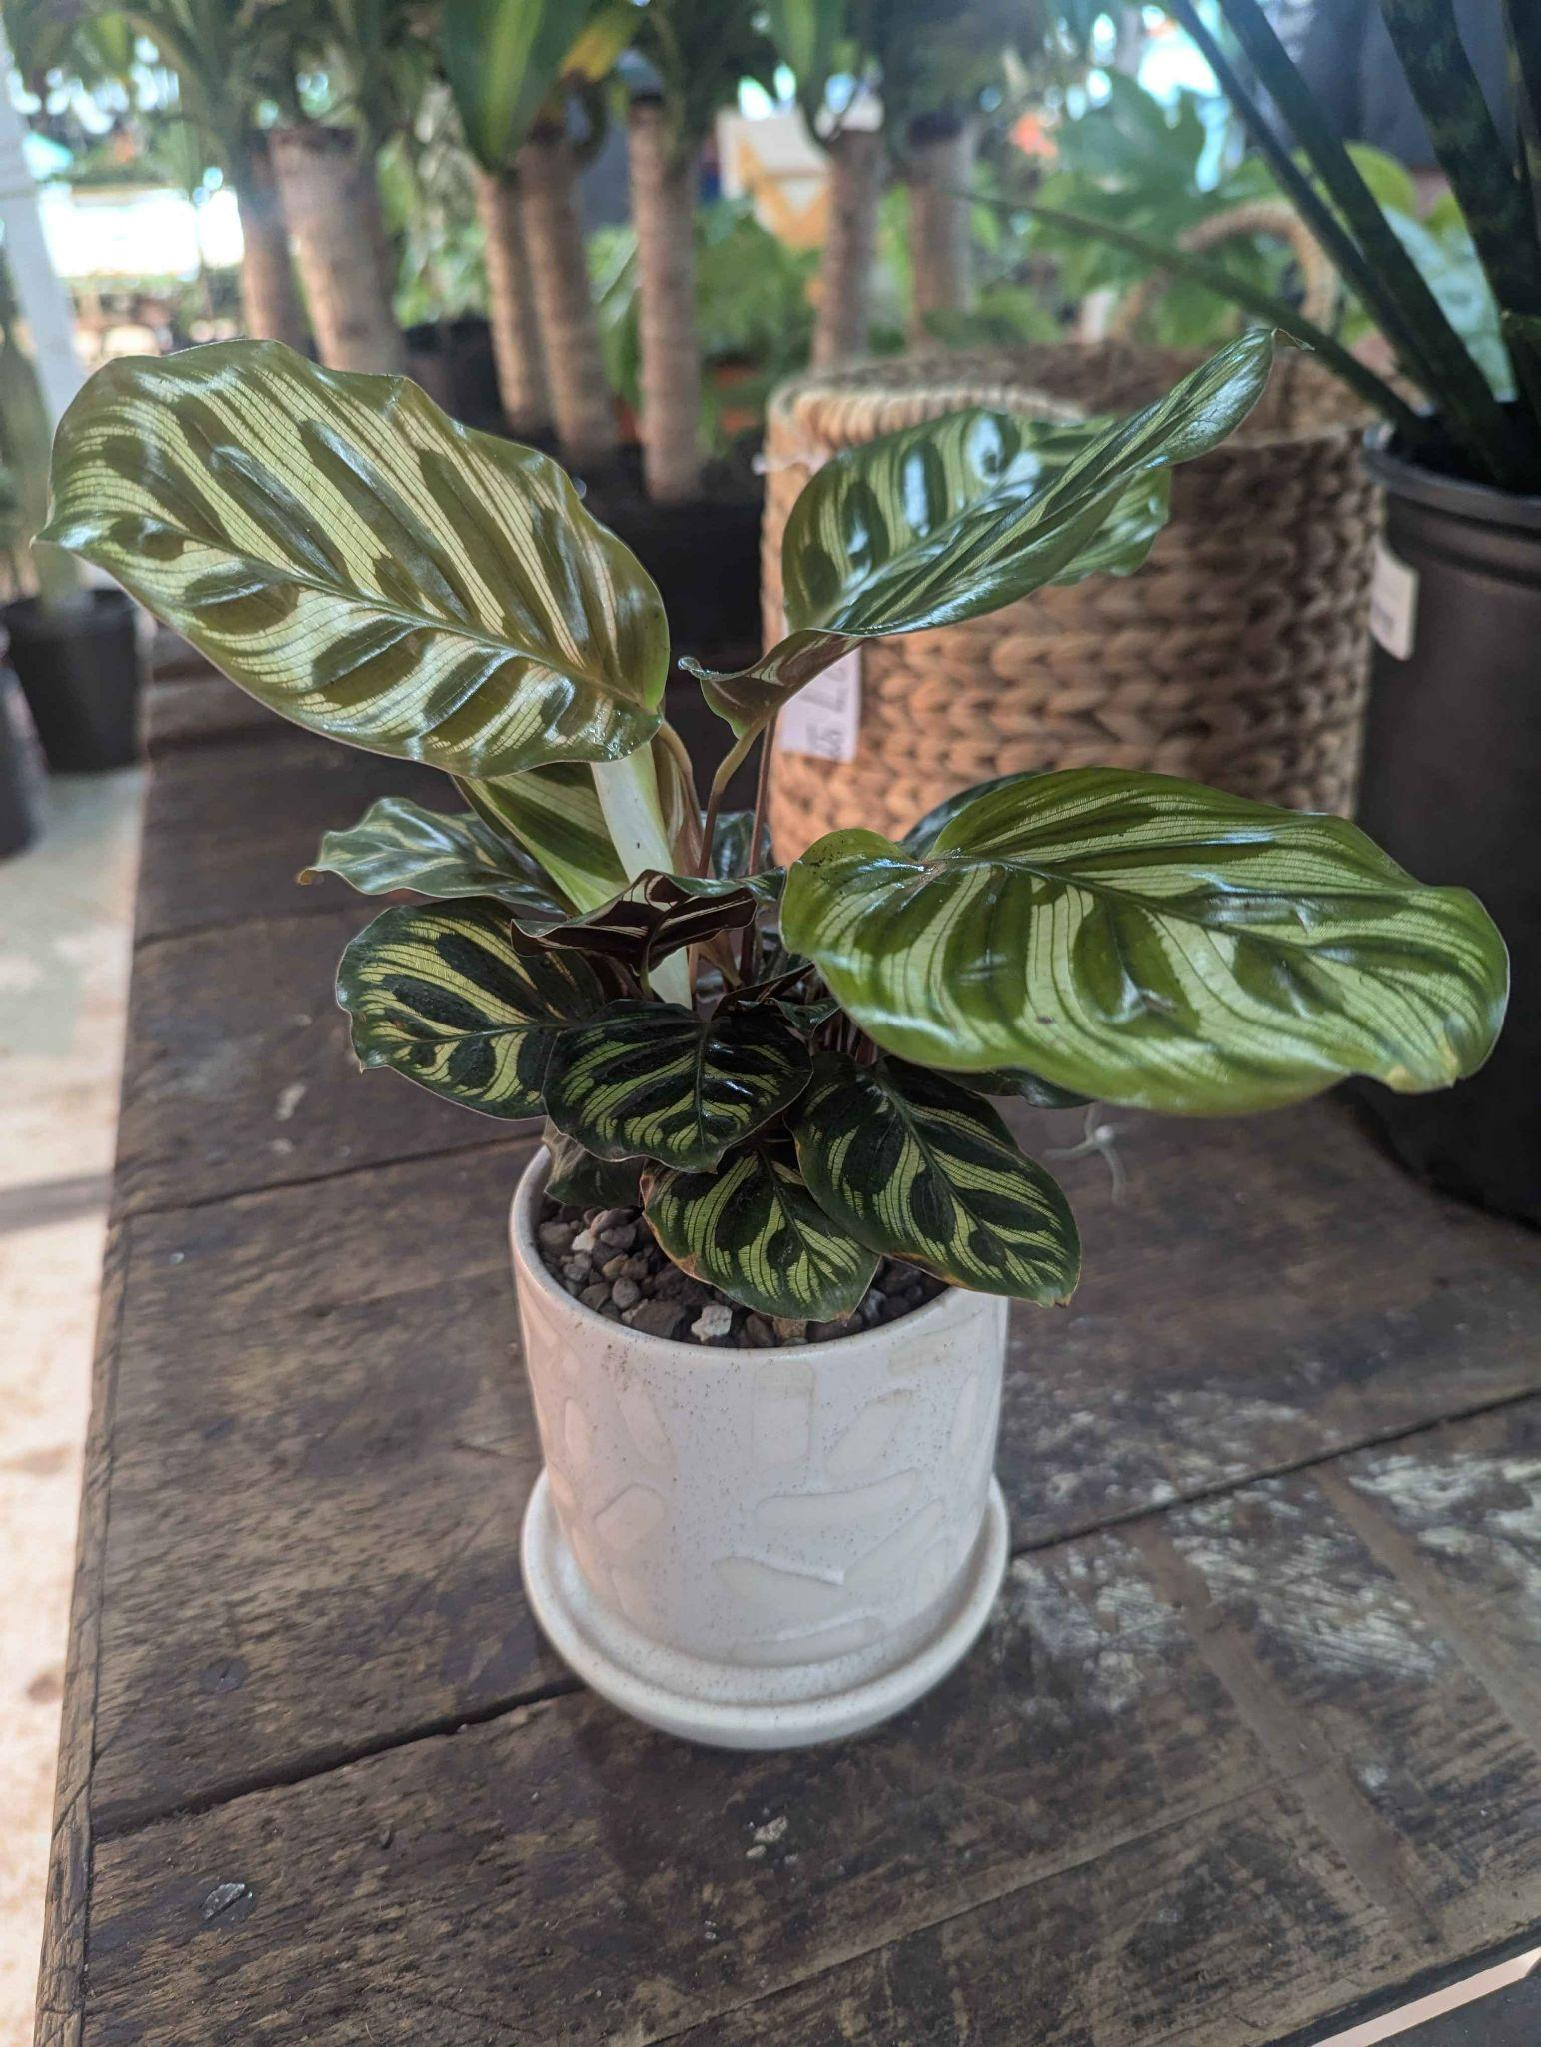
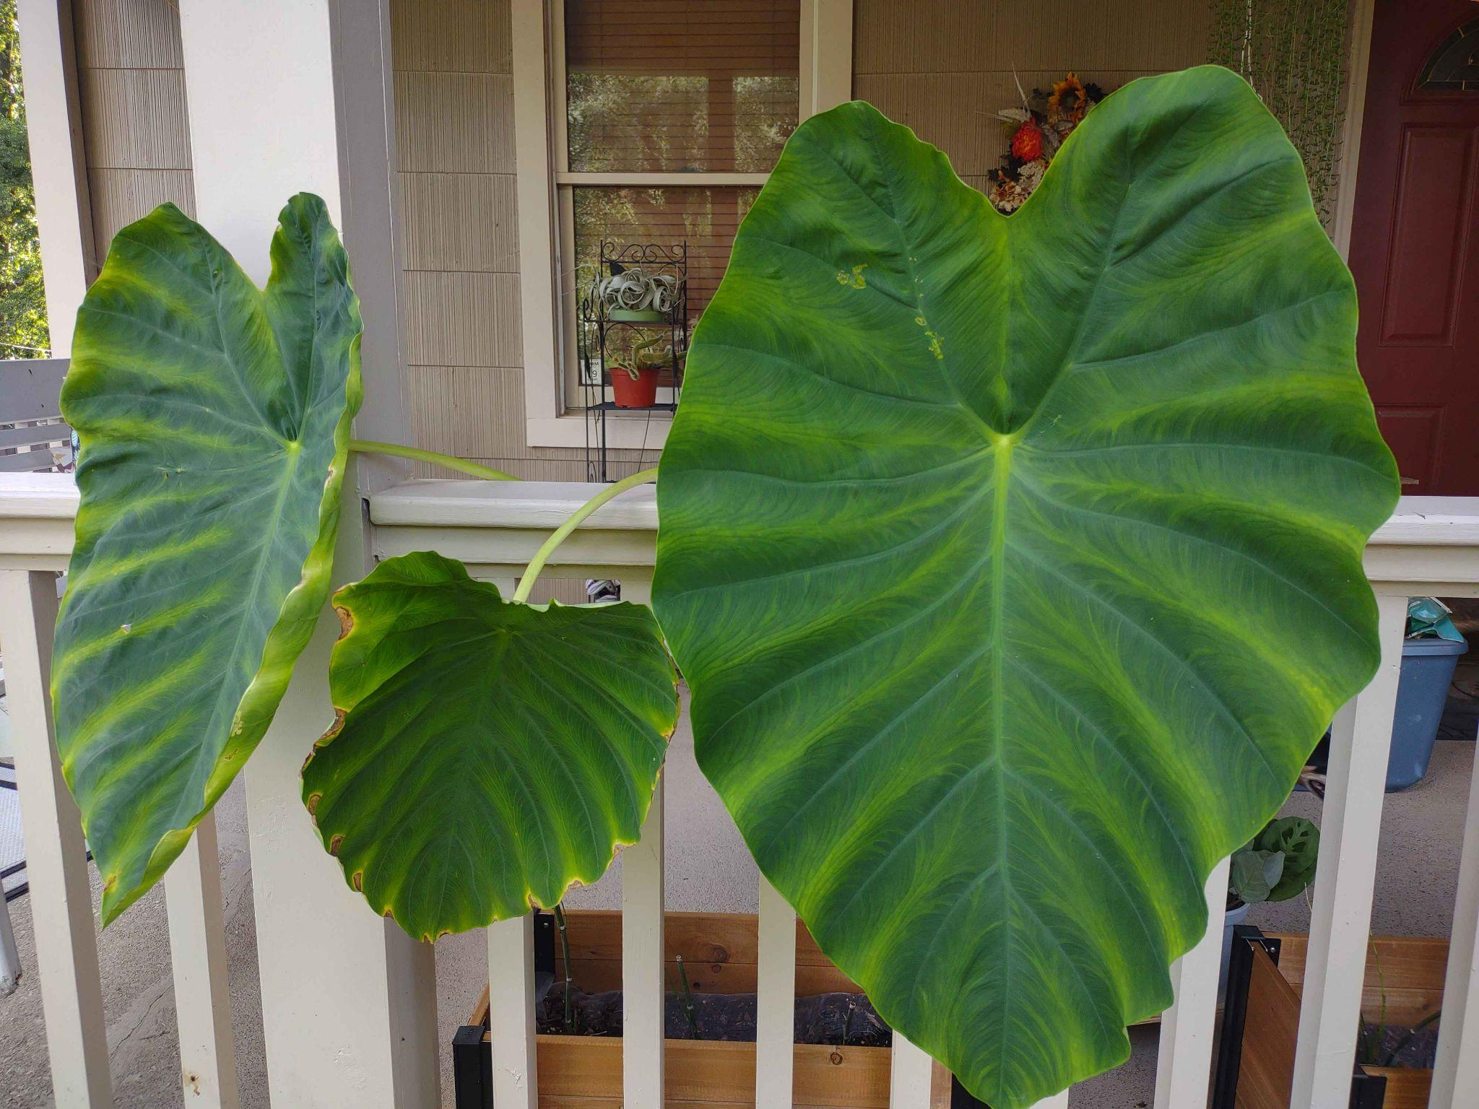
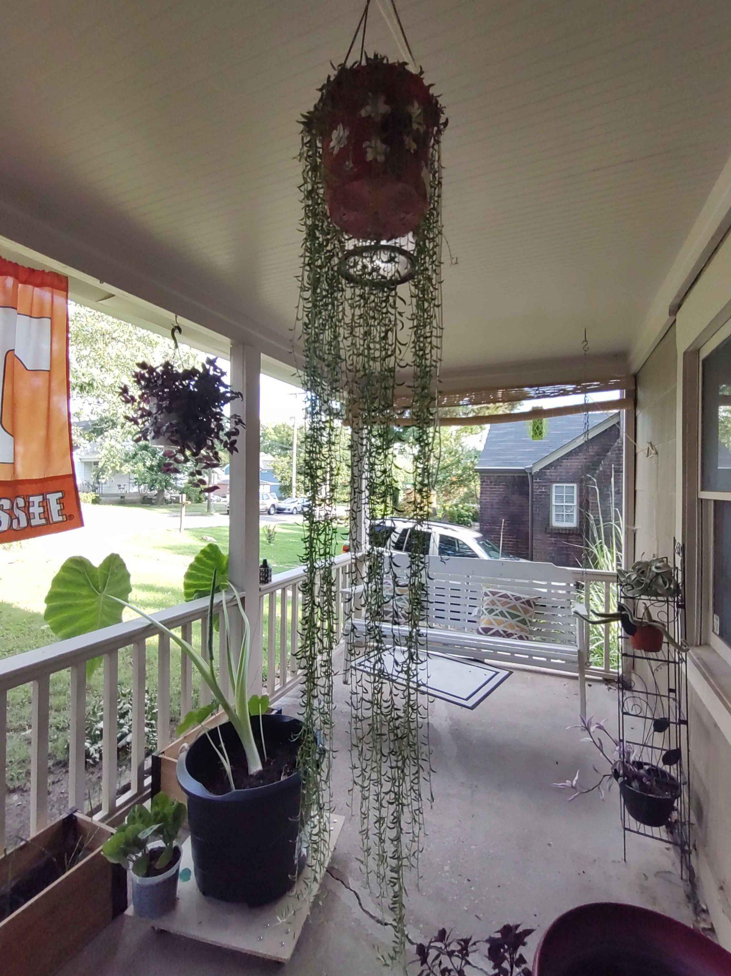
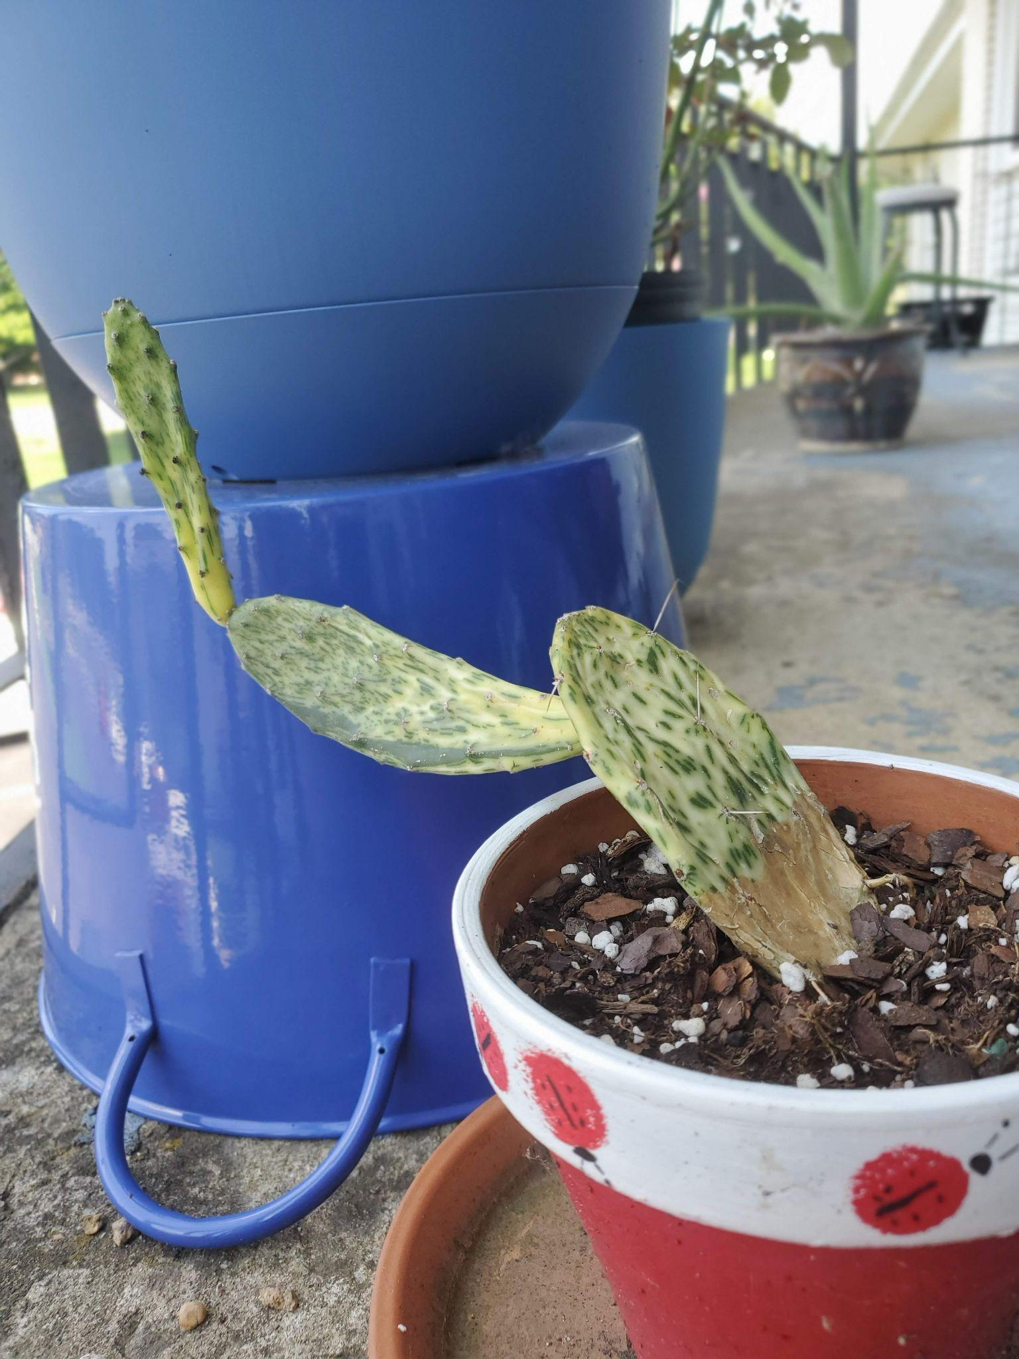
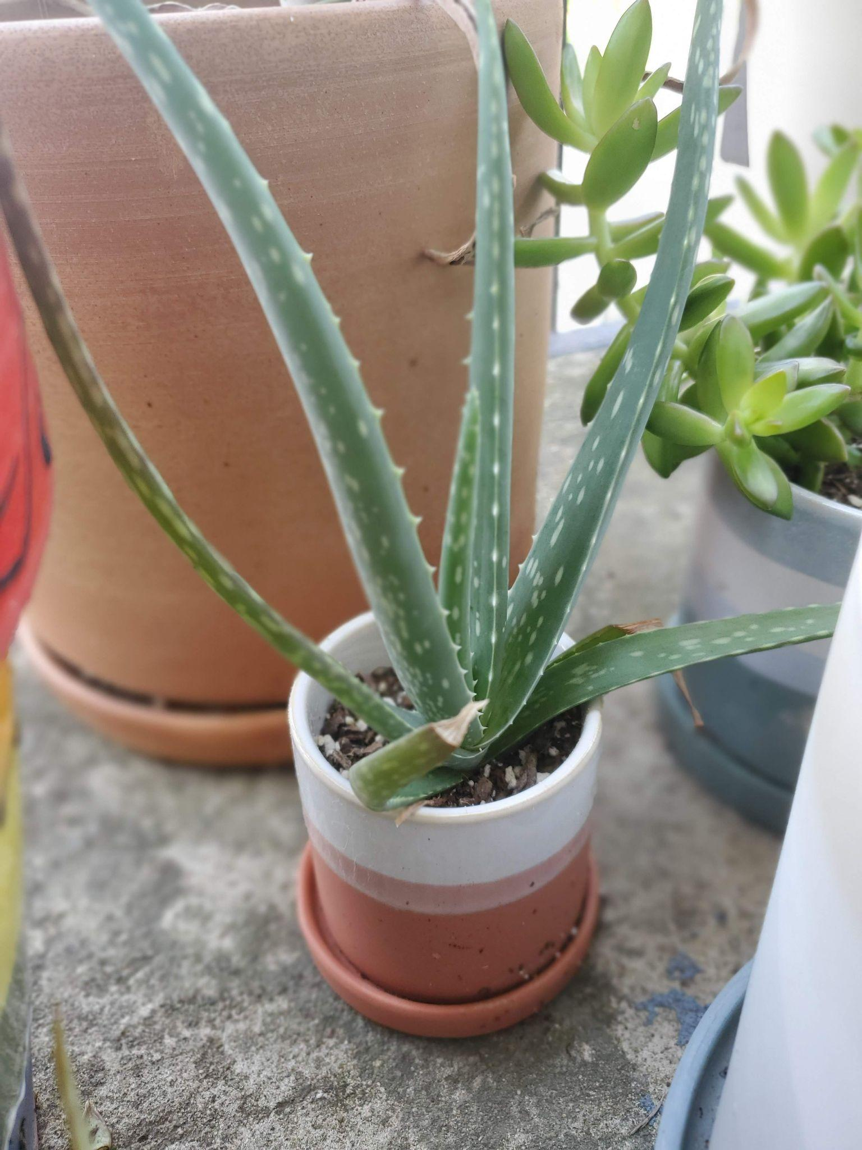
Dashboard: find some plants!
Plant Finder Dashboard
From left to right: Morticia, Hai, Pickle, Unnamed, Dumbo, Nessie, Sheldon, Rapunzel
Notes:
That is a tool to find plants

Slide 14
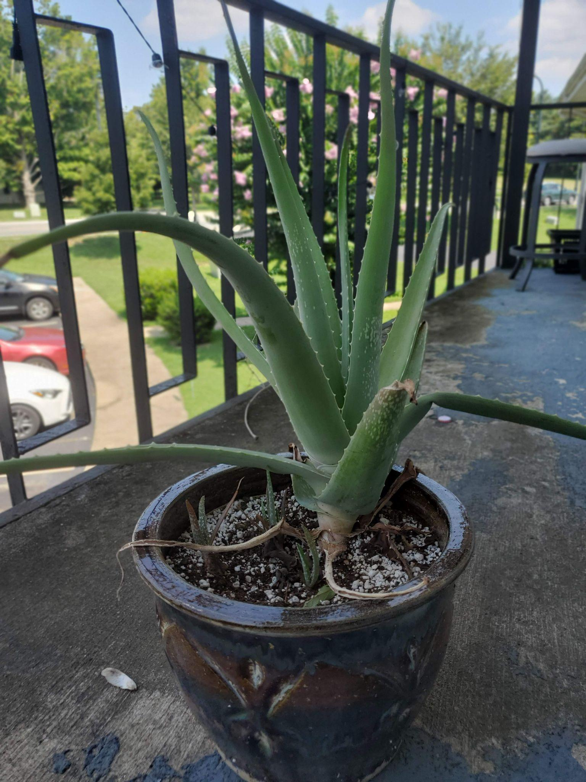
Thank You!
Plants are Friends
Plants increase happiness and productivity, hopefully it is easier to choose now!
Data Sources
https://www.gardenia.net/
https://houseplantsexpert.com
https://brainygardener.com/
Articles
de Seixas M, Williamson D, Barker G, Vickerstaff R. Horticultural therapy in a psychiatric in-patient setting. BJPsych Int. 2017 Nov 1;14(4):87-89. doi:10.1192/s2056474000002087. PMID: 29093958; PMCID: PMC5663021.
Ostner, S. W. (2021). Biophilia hypothesis: The benefits of nature in the workplace. In R. Appel-Meulenbroek & V. Danivska (Eds.), A handbook of theories on designing alignment between people and the office environment (pp. 169–180). Routledge/Taylor & Francis Group. https://doi.org/10.1201/9781003128830-15
Harry the Aloe that Lived

